Slide 2
"The simple graph has brought more information to the data analyst’s mind than any other device. "
- John Tukey

Slide 3
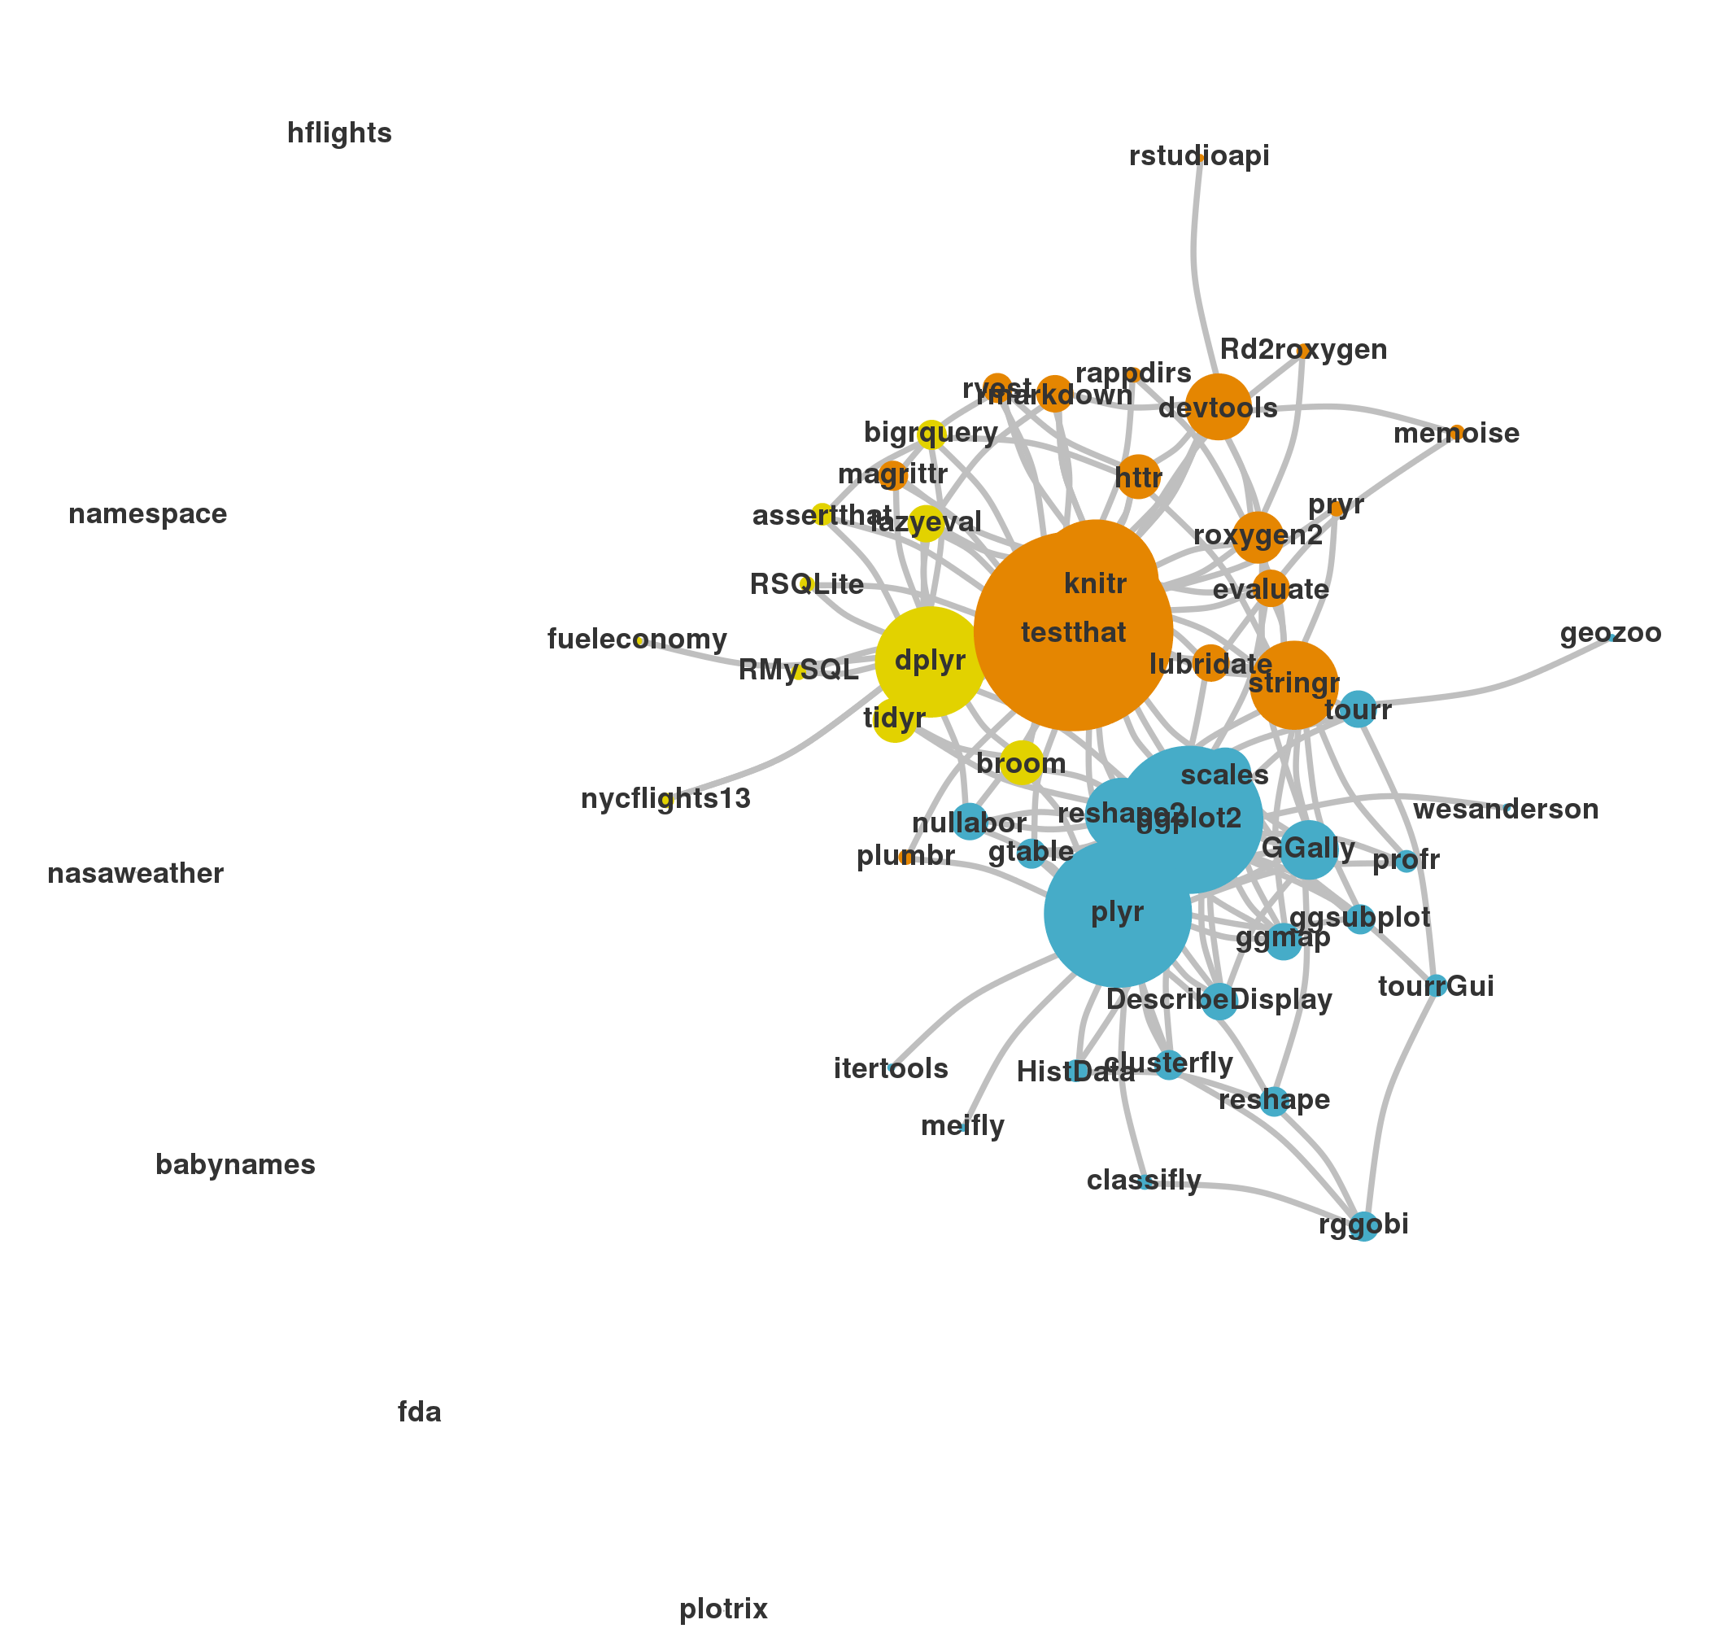
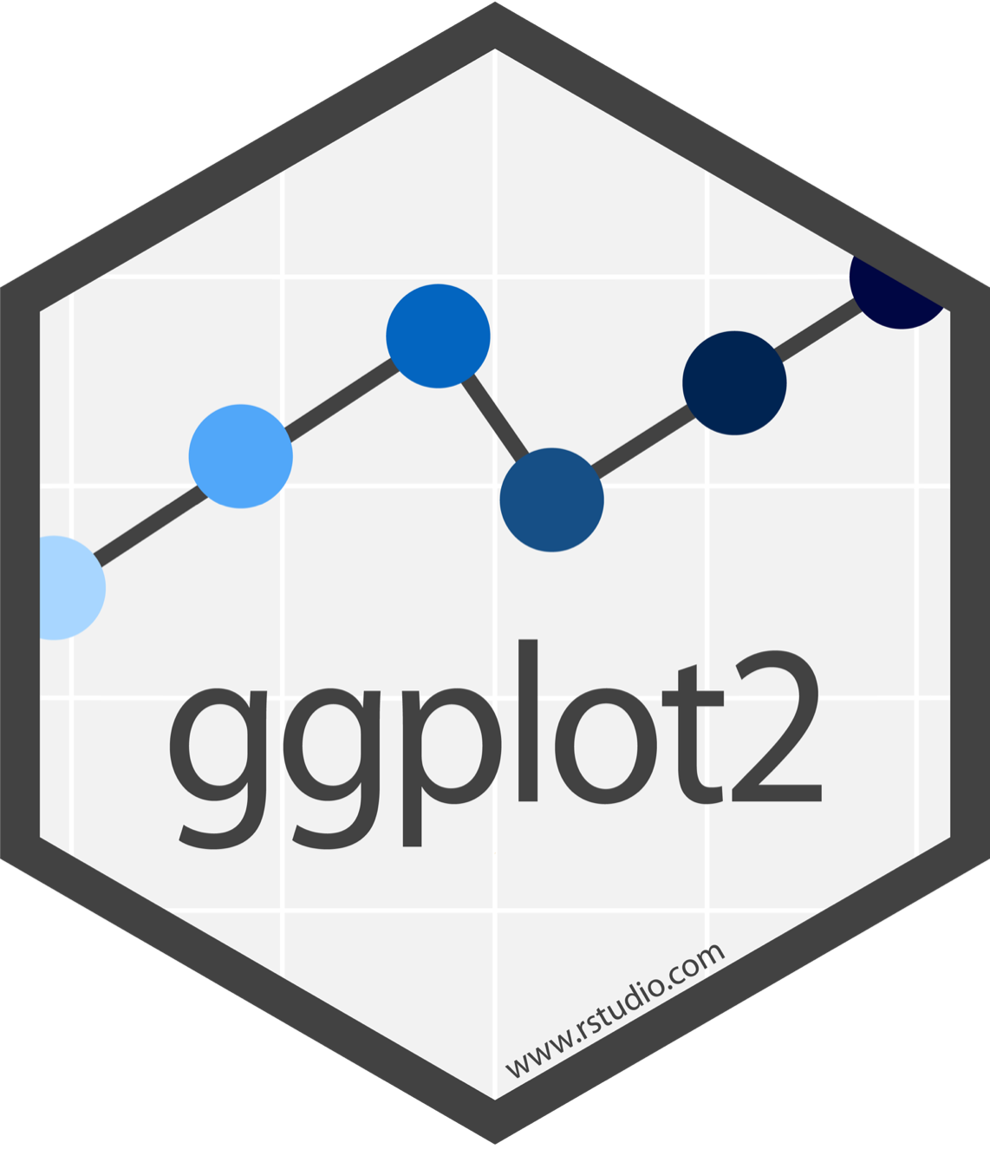
Display by Adolfo A ́lvarez
CC BY-SA RStudio

Slide 4
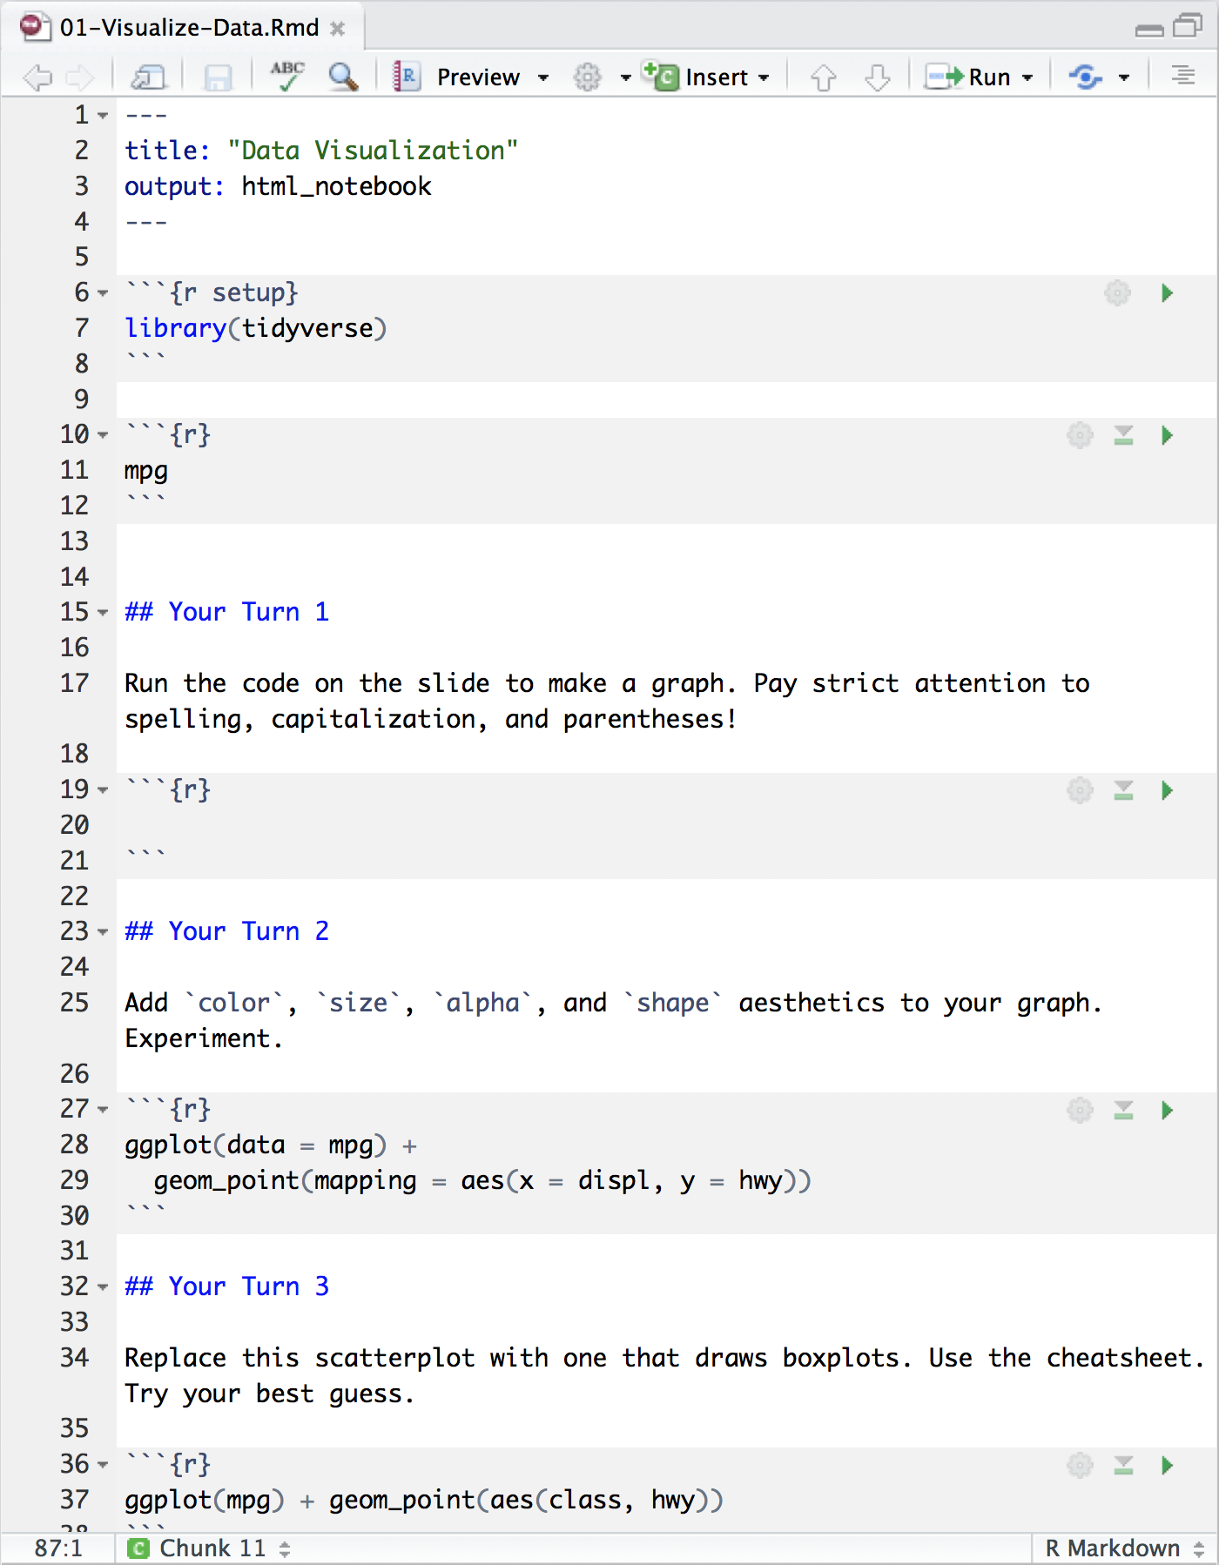
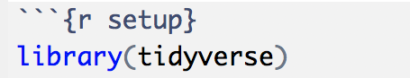
Setup
The setup chunk is always run once before anything else
chunk labels are optional,
the setup label is special
CC BY-SA RStudio

Slide 5
mpg
Fuel economy data for 38 models of car.
mpg
CC BY-SA RStudio

Slide 6

Quiz
Confer with your group.
What relationship do you expect to see between engine size (displ) and mileage (hwy)?
No peeking ahead!

Slide 7
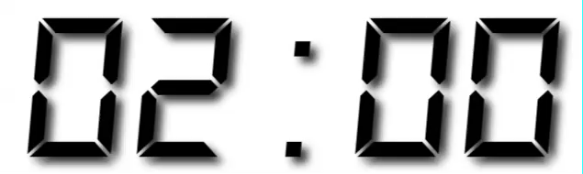
Your Turn 1
Run this code in your notebook to make a graph.
Pay strict attention to spelling, capitalization, and parentheses!
ggplot(data = mpg) +
geom_point(mapping = aes(x = displ, y = hwy))

Slide 8
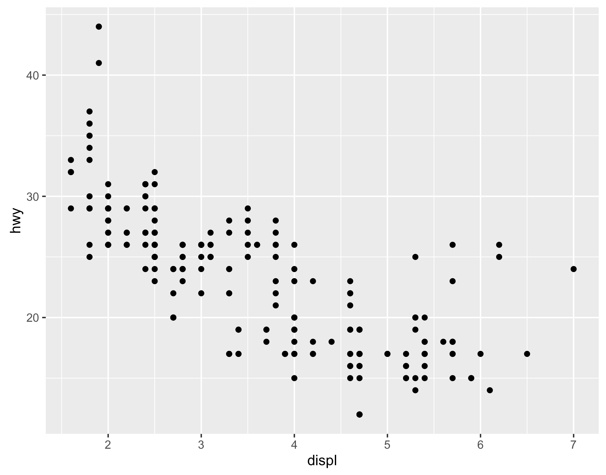
ggplot(data = mpg) +
geom_point(mapping = aes(x = displ, y = hwy))
CC BY-SA RStudio

Slide 9
"Initialize" a plot with ggplot()
Add layers with geom_ functions
ggplot(data = mpg) +
geom_point(mapping = aes(x = displ, y = hwy))
CC BY-SA RStudio

Slide 10
Pro tip: Always put the + at the end of a line, Never at the start
ggplot(data = mpg) +
geom_point(mapping = aes(x = displ, y = hwy))
CC BY-SA RStudio

Slide 11
data
+ before new line
ggplot(data = mpg) +
geom_point(mapping = aes(x = displ, y = hwy))
type of layer
aes( )
x
y variable
CC BY-SA RStudio

Slide 12
A template
ggplot(data = <DATA>) +
<GEOM_FUNCTION>(mapping = aes(<MAPPINGS>))
ggplot(data = mpg) +
geom_point(mapping = aes(x = displ, y = hwy))
CC BY-SA RStudio

Slide 13
A template
ggplot(data = <DATA>) +
<GEOM_FUNCTION>(mapping = aes(<MAPPINGS>))
CC BY-SA RStudio

Slide 14

Mappings

Slide 15
"The greatest value of a picture is when it forces us to notice what we never expected to see."
- John Tukey

Slide 16
How can we test the theory?
Why do these cars get better mileage?
ggplot(data = mpg) +
geom_point(mapping = aes(x = displ, y = hwy))
CC BY-SA RStudio

Slide 17
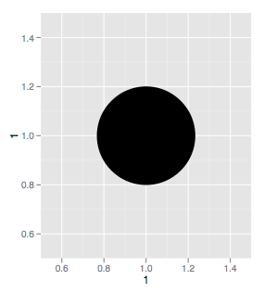
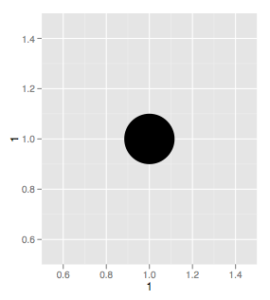
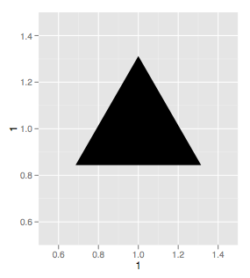
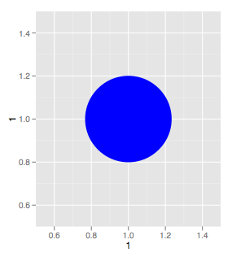
Aesthetics
CC BY-SA RStudio

Slide 18
Visual Space
Data Space
color
class
Red
Brown
Green
Aqua
Blue
Violet
Pink
2seater
compact
midsize
minivan
pickup
subcompact
suv
CC BY-SA RStudio

Slide 19
Aesthetics
aesthetic property
Variable to map it to
ggplot(mpg) + geom_point(aes(x = displ, y = hwy, color = class))
ggplot(mpg) + geom_point(aes(x = displ, y = hwy, size = class))
ggplot(mpg) + geom_point(aes(x = displ, y = hwy, shape = class))
ggplot(mpg) + geom_point(aes(x = displ, y = hwy, alpha = class))
CC BY-SA RStudio

Slide 20
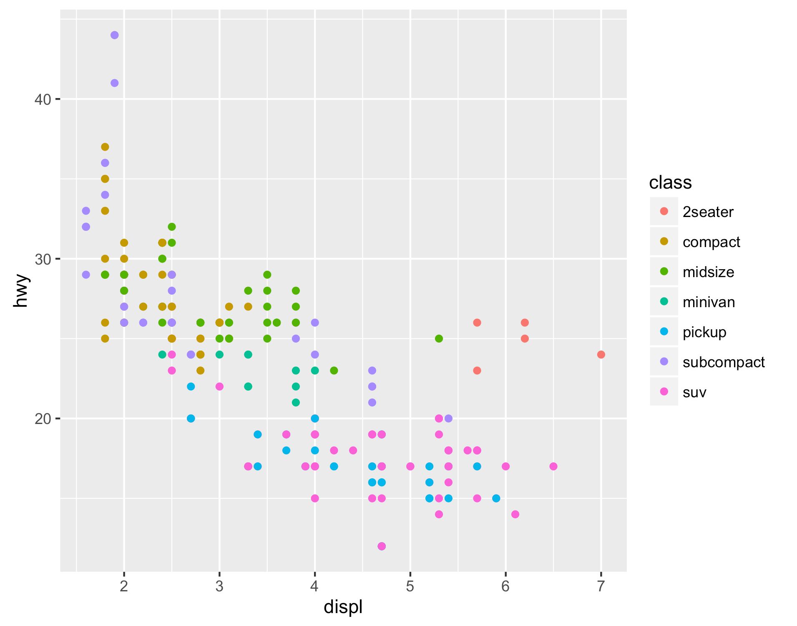
Legend added automatically
ggplot(data = mpg) +
geom_point(mapping = aes(x = displ, y = hwy, color = class))
CC BY-SA RStudio

Slide 21
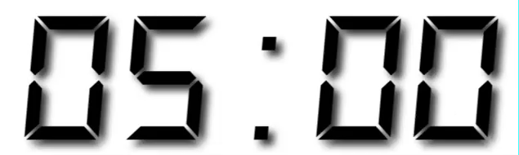
Your Turn 2
In the next chunk, add color, size, alpha, and shape aesthetics to your graph. Experiment.
Do different things happen when you map aesthetics to discrete and continuous variables?
What happens when you use more than one aesthetic?

Slide 22
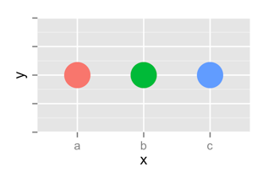
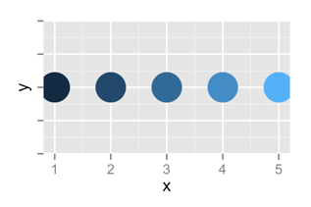
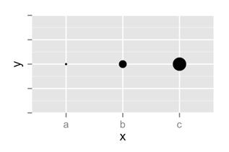
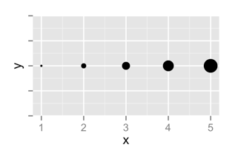
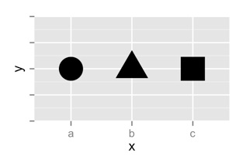
 | Discrete | Continuous
Color
Size
Shape
CC BY-SA RStudio

Slide 23
set vs. map

Slide 24
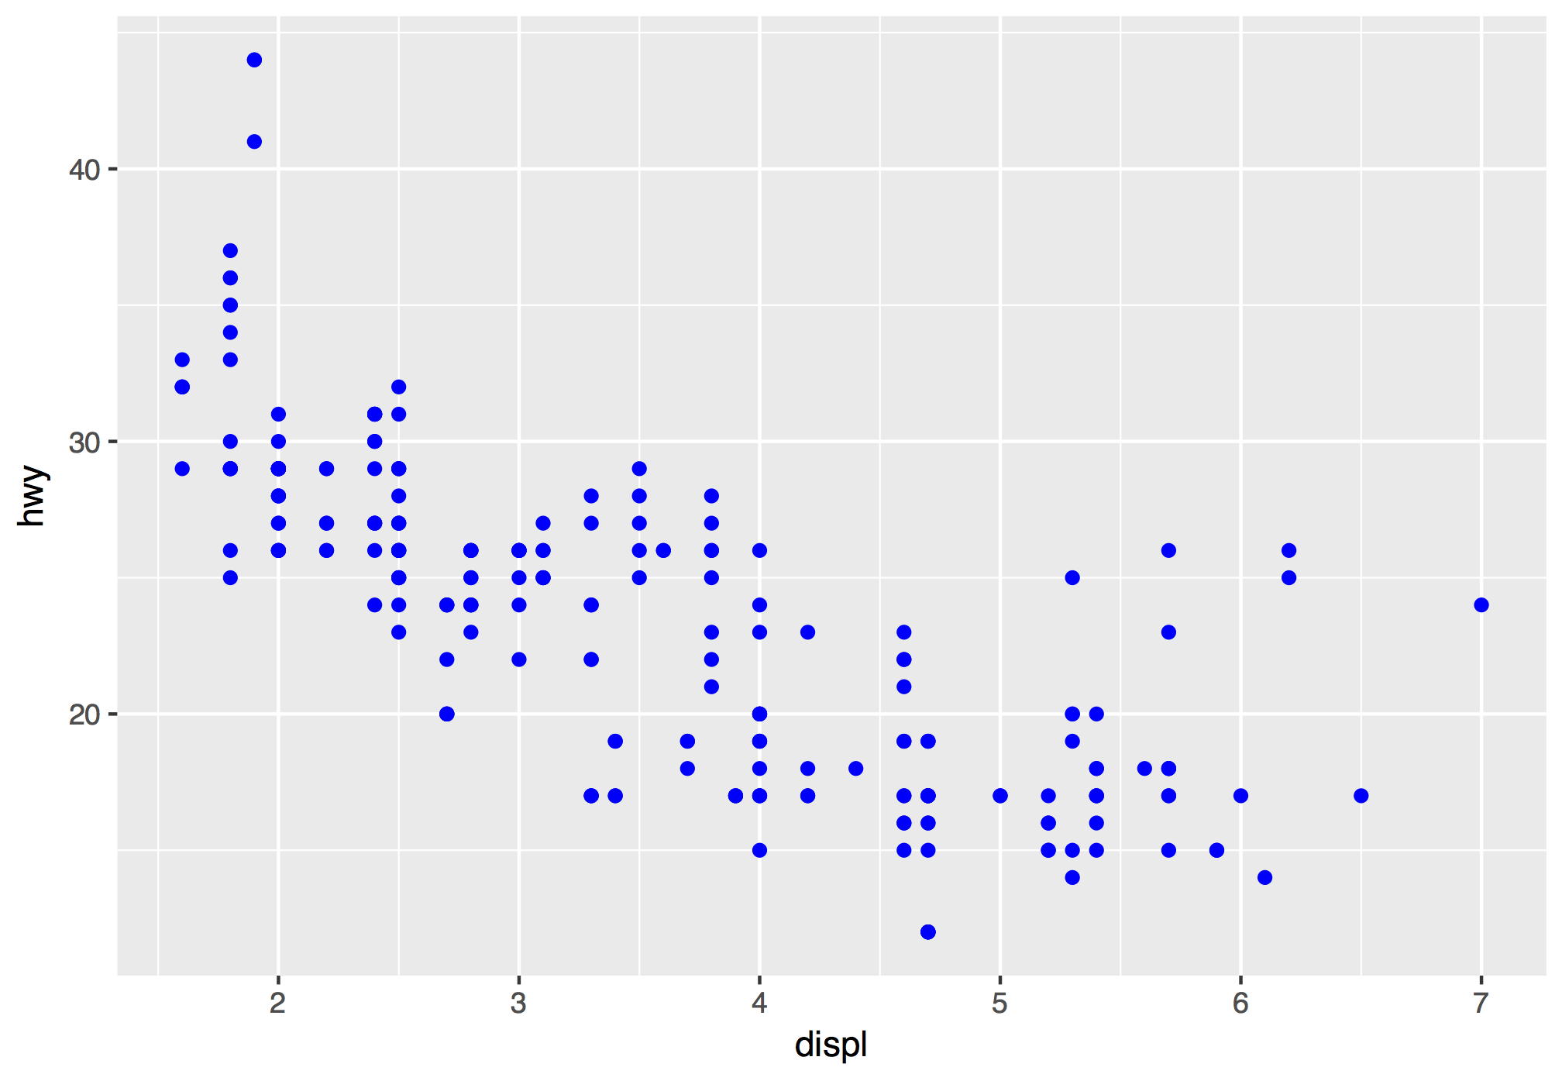
How would you make this plot?
CC BY-SA RStudio

Slide 25
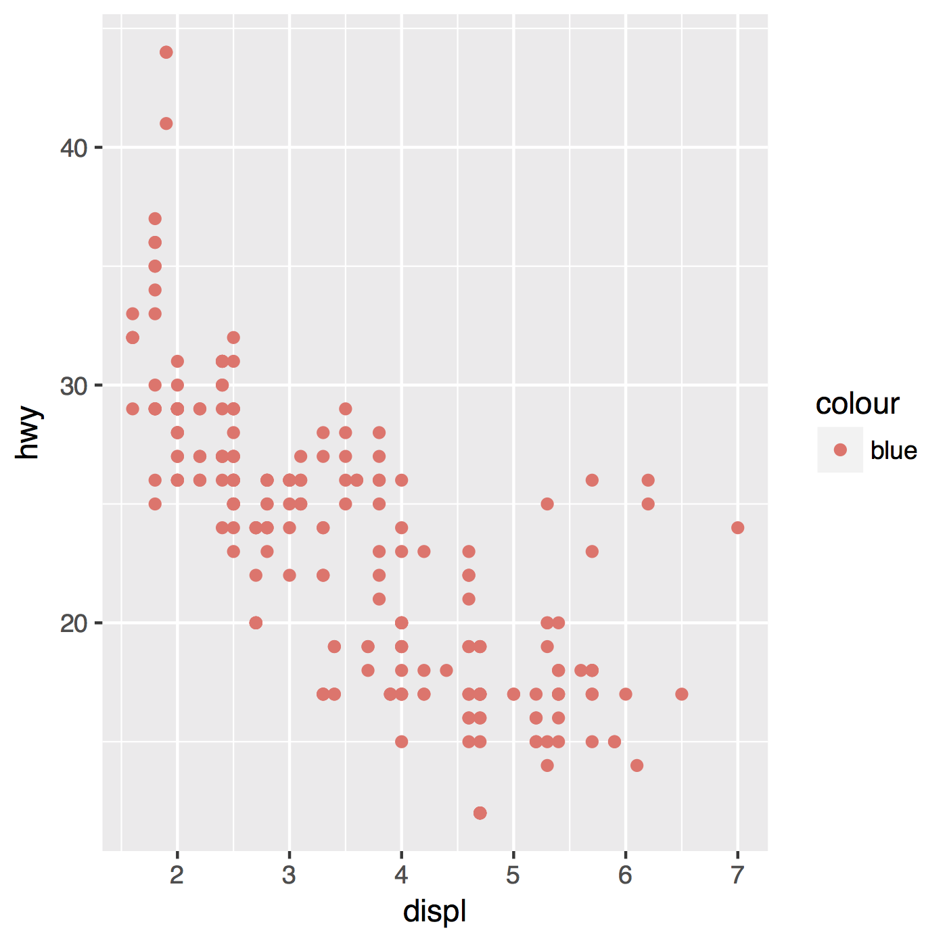
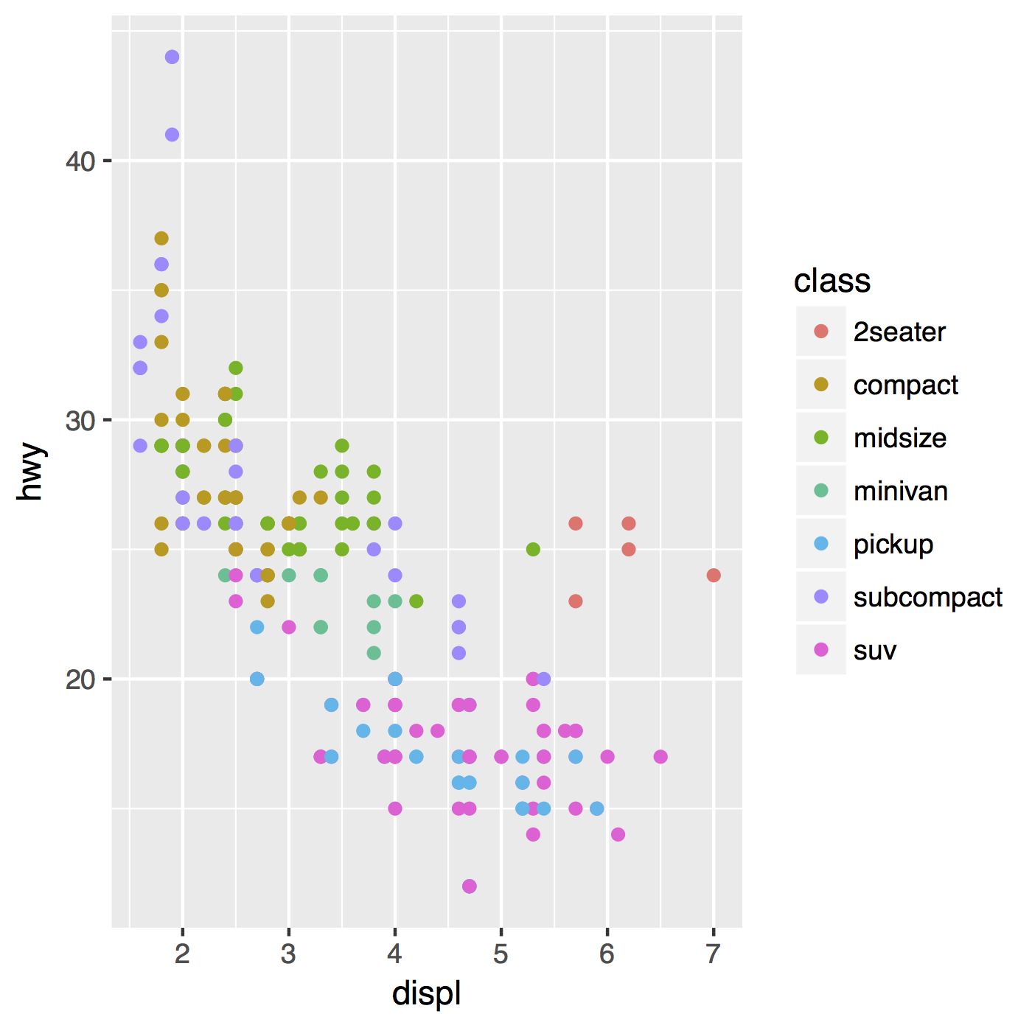
Inside of aes(): maps an aesthetic to a variable
ggplot(mpg) + geom_point(aes(x = displ, y = hwy, color = class))
CC BY-SA RStudio

Slide 26
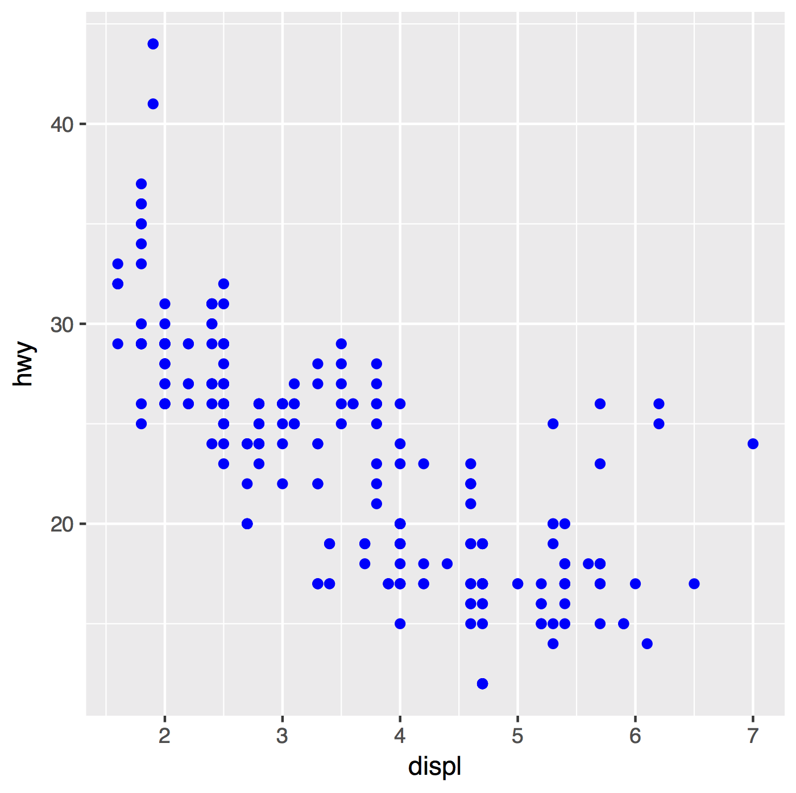
Outside of aes(): sets an aesthetic to a value
ggplot(mpg) + geom_point(aes(x = displ, y = hwy, color = class))
ggplot(mpg) + geom_point(aes(x = displ, y = hwy), color = "blue")
CC BY-SA RStudio

Slide 27
ggplot(mpg) + geom_point(aes(x = displ, y = hwy, color = class))
ggplot(mpg) + geom_point(aes(x = displ, y = hwy), color = "blue")
CC BY-SA RStudio

Slide 28
ggplot(mpg) + geom_point(aes(x = displ, y = hwy, color = "blue"))
ggplot(mpg) + geom_point(aes(x = displ, y = hwy), color = "blue")
CC BY-SA RStudio

Slide 29
Geoms

Slide 30
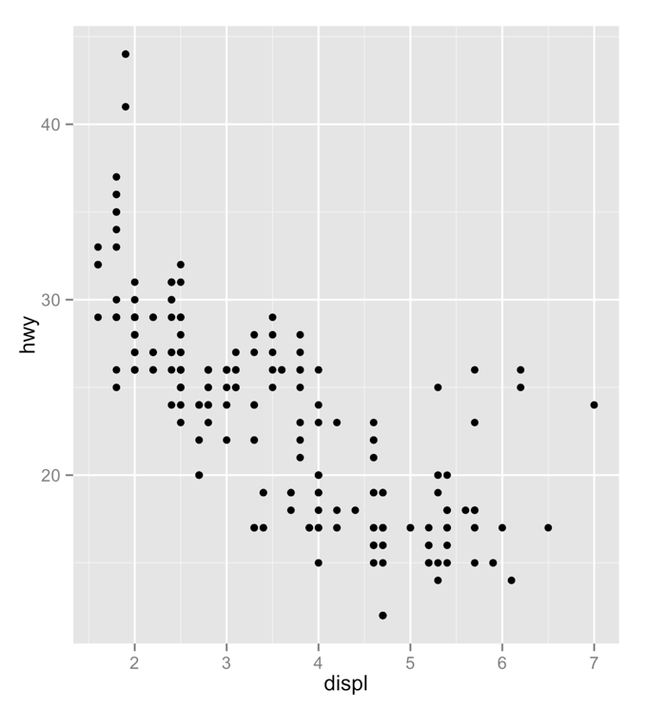
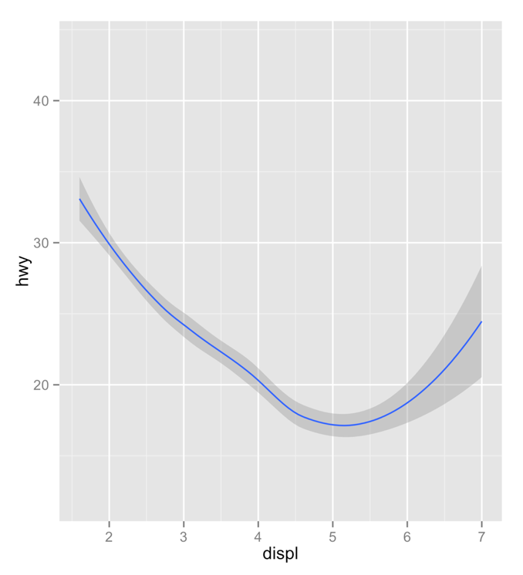
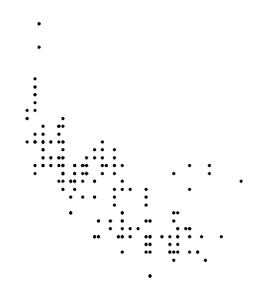
How are these plots similar?
Same:
x var
, y var
, data
CC BY-SA RStudio

Slide 31
How are these plots different?
Different: geometric object (geom),
e.g. the visual object used to represent the data
CC BY-SA RStudio

Slide 32
geoms
ggplot(data = <DATA>) +
<GEOM_FUNCTION>(mapping = aes(<MAPPINGS>))
CC BY-SA RStudio

Slide 33
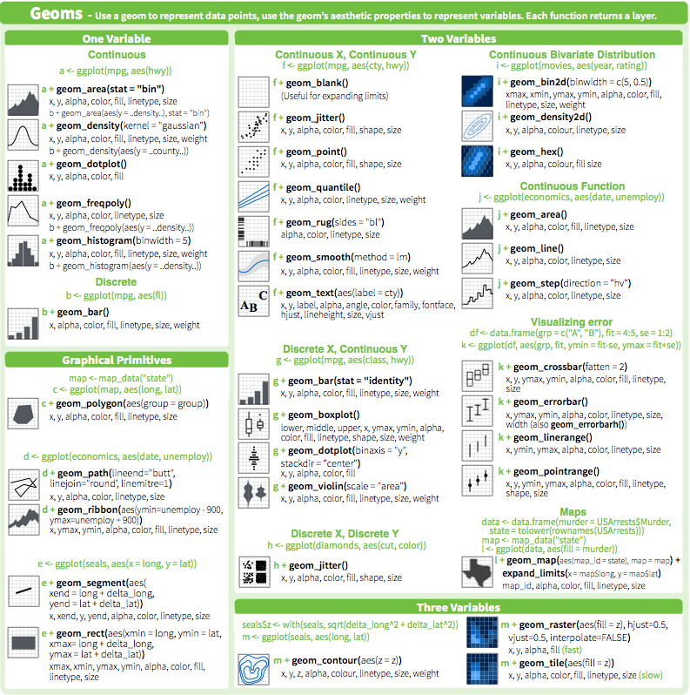
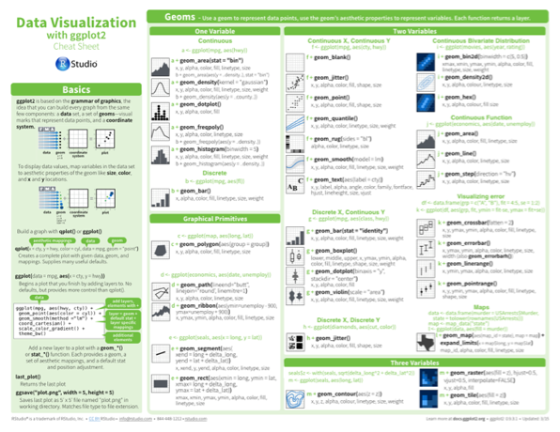
geom_ functions
Each requires a mapping argument.
CC BY-SA RStudio

Slide 34
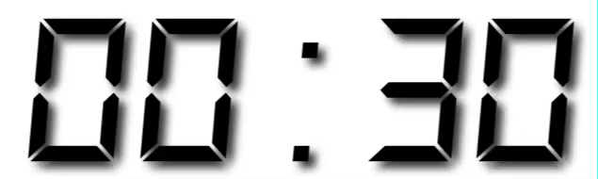
Your Turn
Pair up.

Slide 35
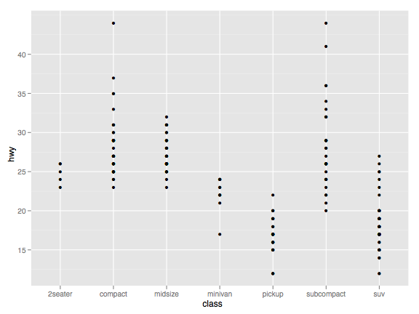
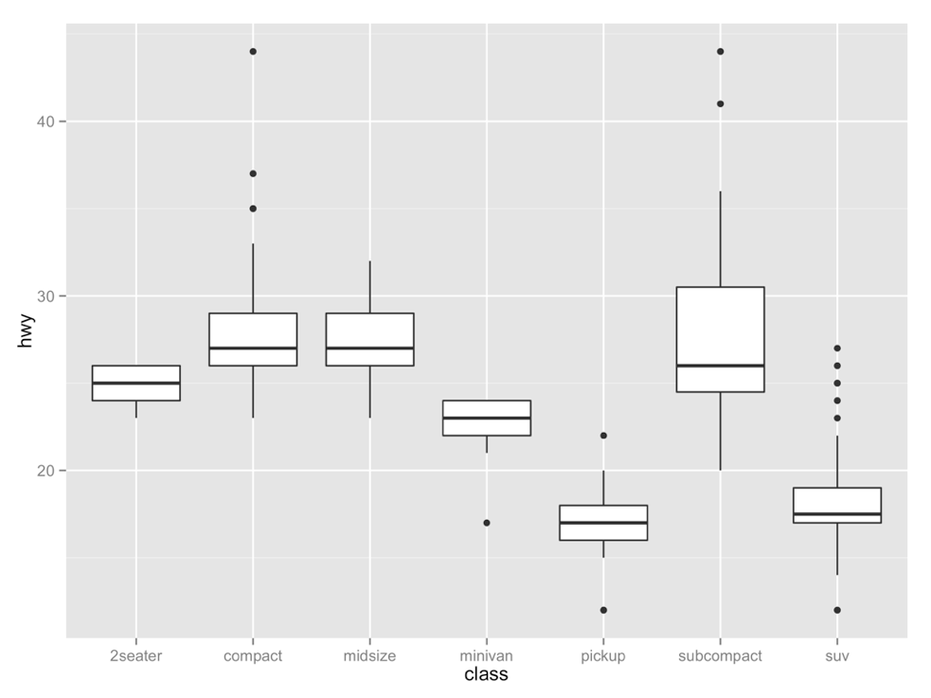
Your Turn 3
With your partner, decide how to replace this scatterplot with one that draws boxplots? Use the cheatsheet. Try your best guess.
ggplot(mpg) + geom_point(aes(class, hwy))

Slide 36
ggplot(data = mpg) +
geom_boxplot(mapping = aes(x = class, y = hwy))
CC BY-SA RStudio

Slide 37
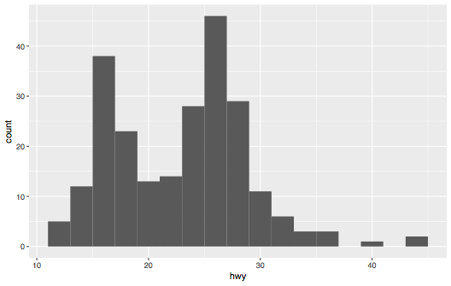
Your Turn 4
With your partner, make the histogram of hwy below. Use the cheatsheet. Hint: do not supply a y variable.

Slide 38
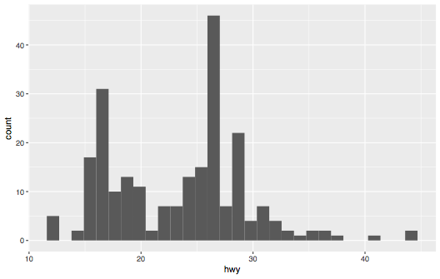
ggplot(data = mpg) +
geom_histogram(mapping = aes(x = hwy))
CC BY-SA RStudio

Slide 39
?
ggplot(data = mpg) +
geom_histogram(mapping = aes(x = hwy), binwidth = 2)
CC BY-SA RStudio

Slide 40
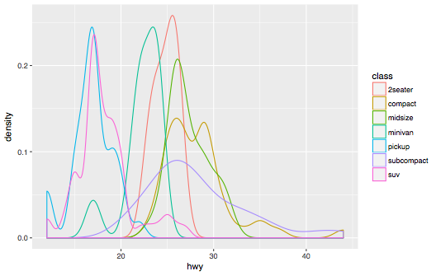
Your Turn 5
With your partner, make the density plot of hwy colored by class below. Use the cheatsheet. Try your best guess.

Slide 41
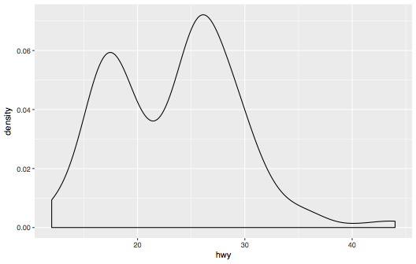
ggplot(data = mpg) +
geom_density(mapping = aes(x = hwy))
CC BY-SA RStudio

Slide 42
ggplot(data = mpg) +
geom_density(mapping = aes(x = hwy, color = class))
CC BY-SA RStudio

Slide 43
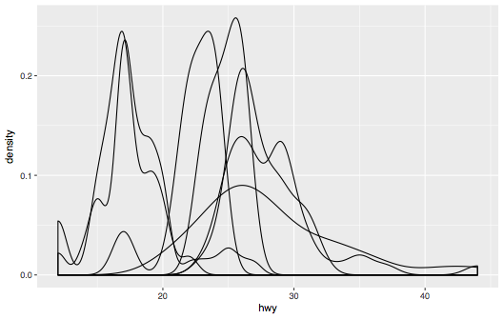
ggplot(data = mpg) +
geom_density(mapping = aes(x = hwy, group = class))
CC BY-SA RStudio

Slide 44
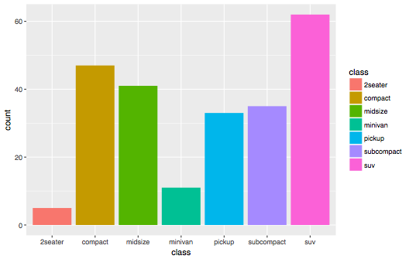
Your Turn 6
With your partner, make the bar chart of hwy colored by class below. Use the cheatsheet. Try your best guess.

Slide 45
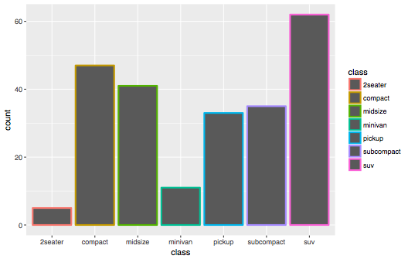
ggplot(data = mpg) +
geom_bar(mapping = aes(x = class, color = class))
CC BY-SA RStudio

Slide 46
ggplot(data = mpg) +
geom_bar(mapping = aes(x = class, fill = class))
CC BY-SA RStudio

Slide 47
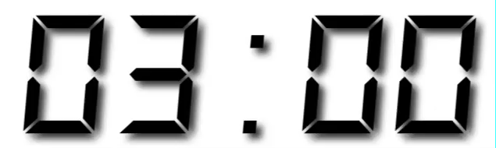
Your Turn 7
With your partner, predict what this code will do.
Then run it.
ggplot(mpg) +
geom_point(aes(displ, hwy)) +
geom_smooth(aes(displ, hwy))

Slide 48
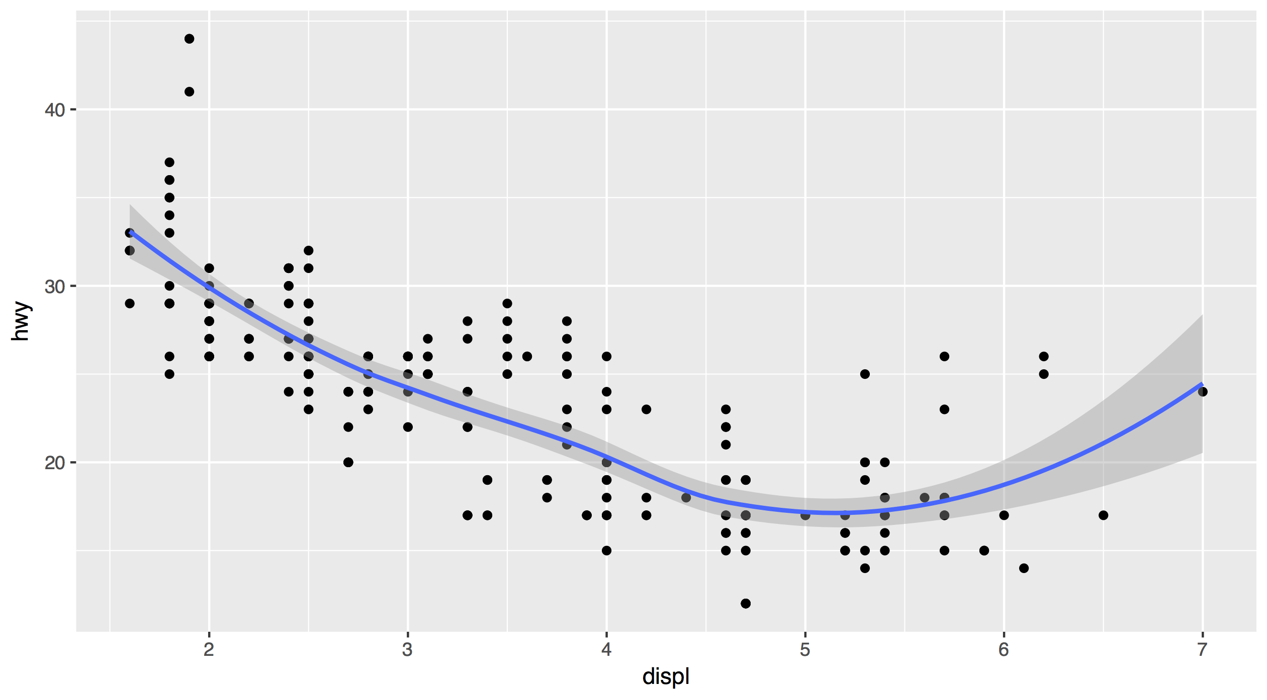
Each new geom adds a new layer
ggplot(data = mpg) +
geom_point(mapping = aes(x = displ, y = hwy)) +
geom_smooth(mapping = aes(x = displ, y = hwy))
CC BY-SA RStudio

Slide 49
Each new geom adds a new layer
ggplot(data = mpg) +
geom_point(mapping = aes(x = displ, y = hwy)) +
geom_smooth(mapping = aes(x = displ, y = hwy))
CC BY-SA RStudio

Slide 50
global vs. local

Slide 51
Mappings (and data) that appear in ggplot() will apply globally to every layer
ggplot(data = mpg, mapping = aes(x = displ, y = hwy)) +
geom_point() +
geom_smooth()
CC BY-SA RStudio

Slide 52
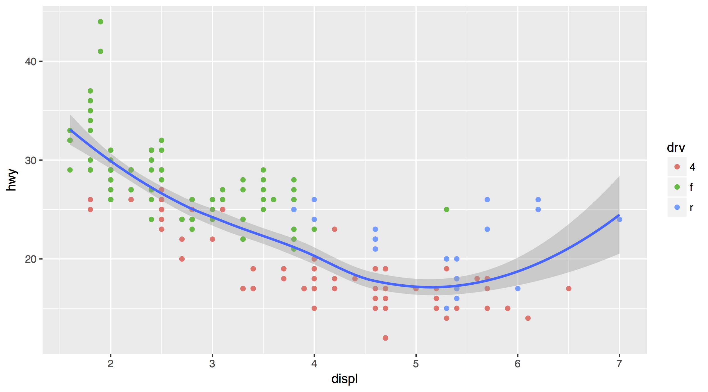
Mappings (and data) that appear in a geom_ function will add to or override the global mappings for that layer only
ggplot(data = mpg, mapping = aes(x = displ, y = hwy)) +
geom_point(mapping = aes(color = drv)) +
geom_smooth()
CC BY-SA RStudio

Slide 53
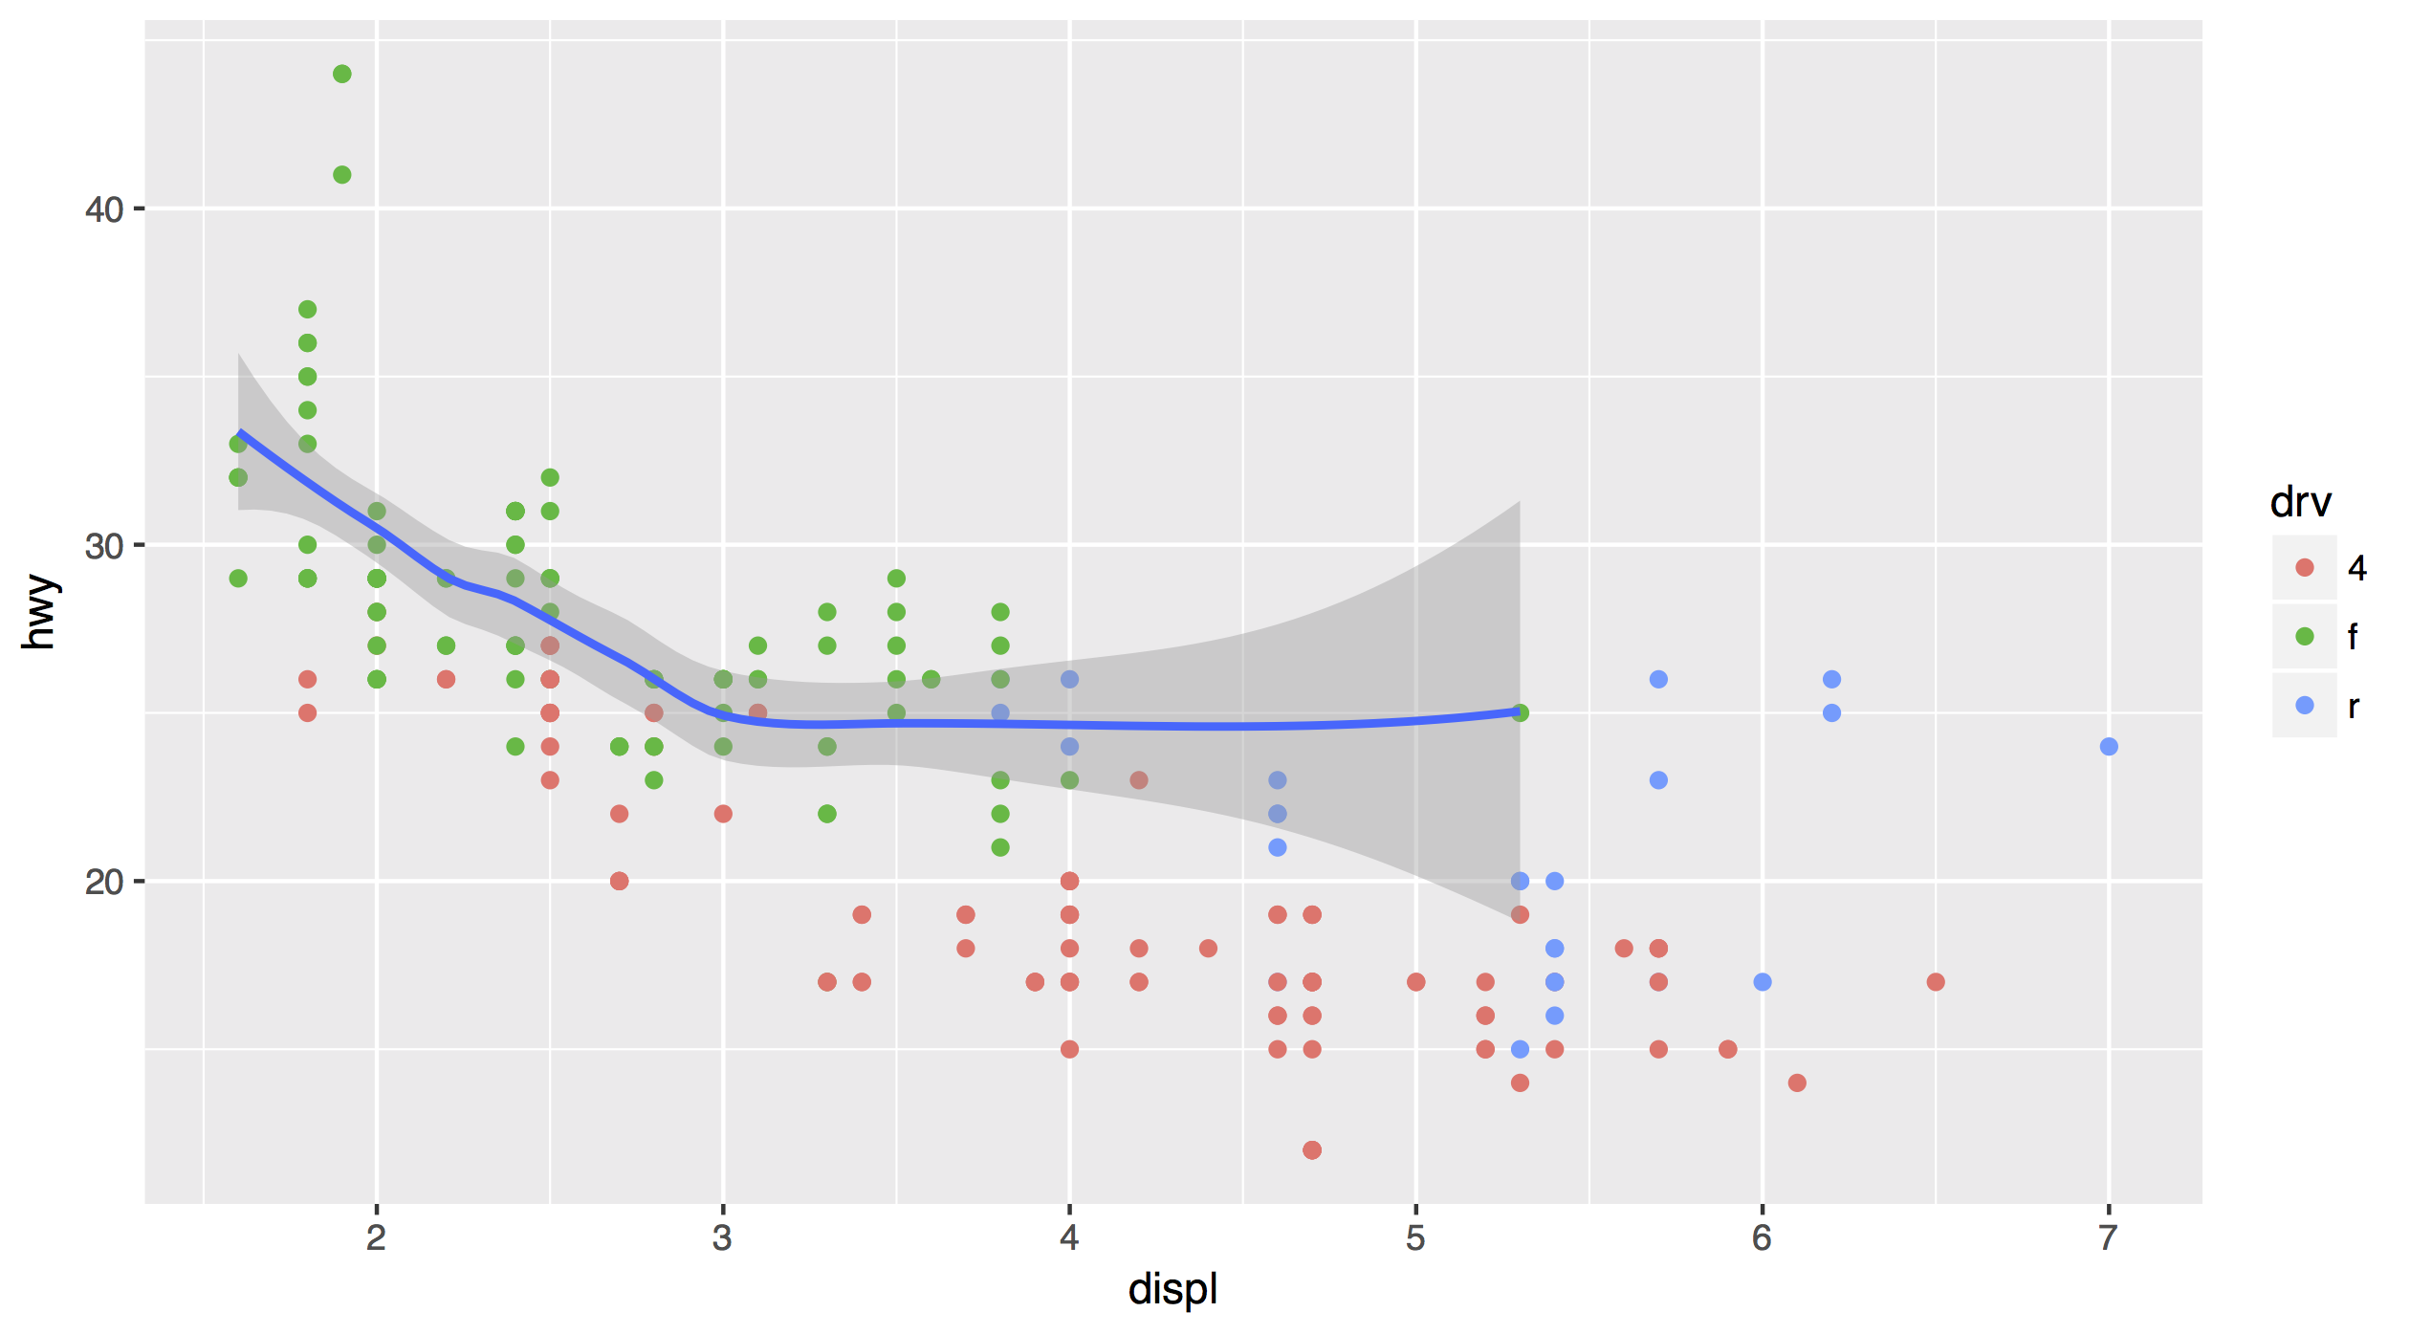
data can also be set locally or globally
ggplot(data = mpg, mapping = aes(x = displ, y = hwy)) +
geom_point(mapping = aes(color = drv)) +
geom_smooth(data = filter(mpg, drv == "f"))
CC BY-SA RStudio

Slide 54
Saving
graphs

Slide 55
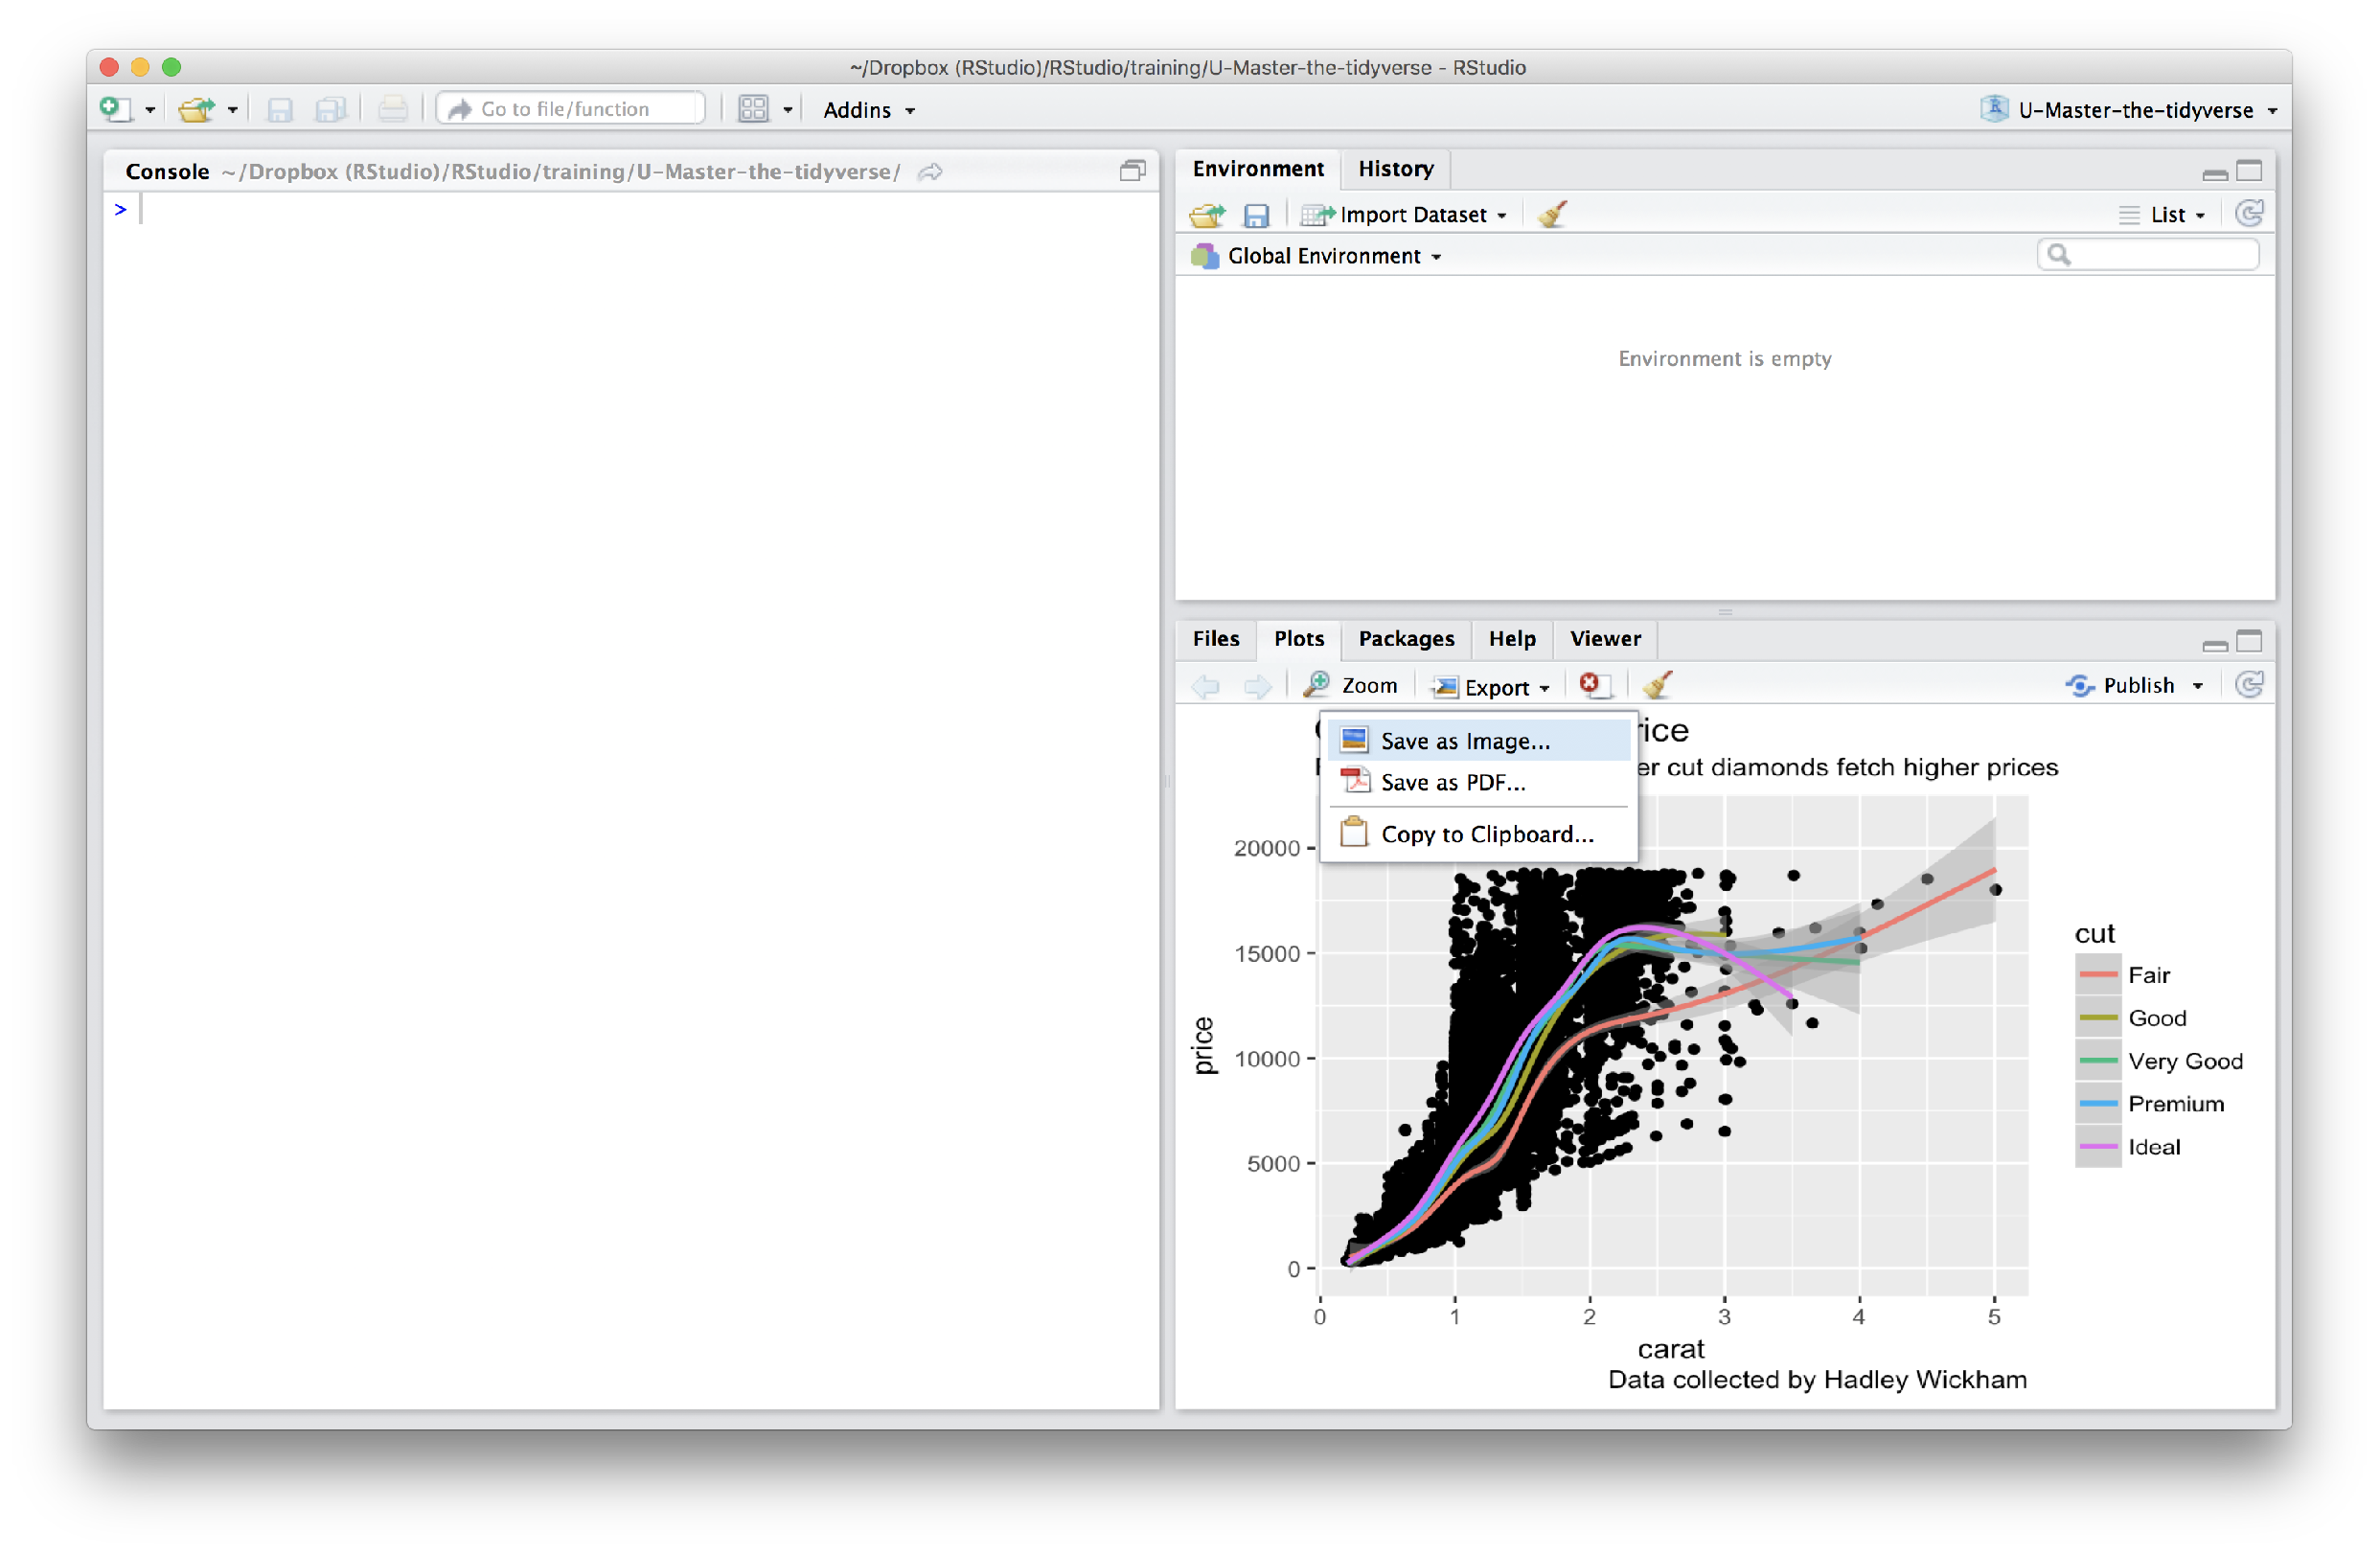
Manually saving plots
Save plots manually with the export menu
CC BY-SA RStudio

Slide 56
Your Turn 8
What does this command return?
getwd()

Slide 57
Working directory
R associates itself with a folder (i.e. directory) on your computer.
This folder is known as your "working directory"
When you save files, R will save them here
When you load files, R will look for them here
CC BY-SA RStudio

Slide 58
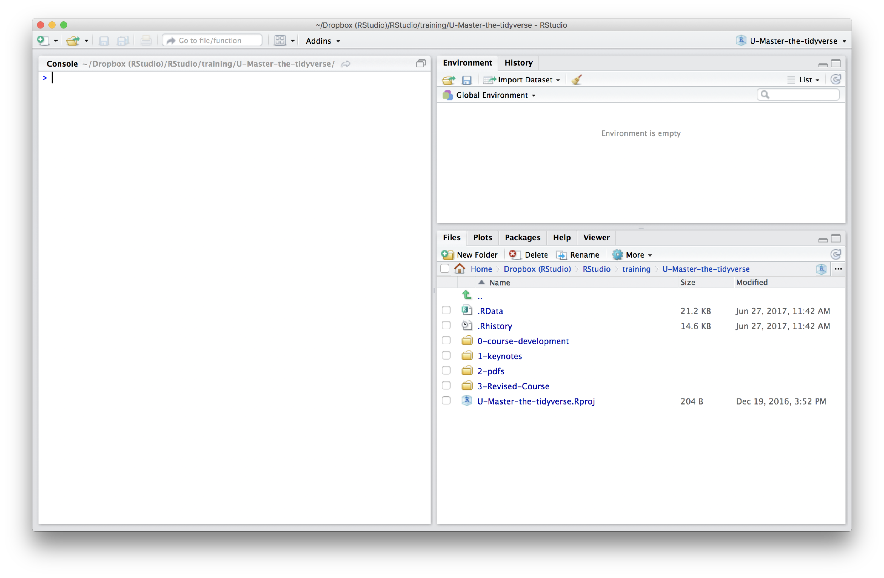
The files pane of the IDE displays the contents of your working directory
CC BY-SA RStudio

Slide 59
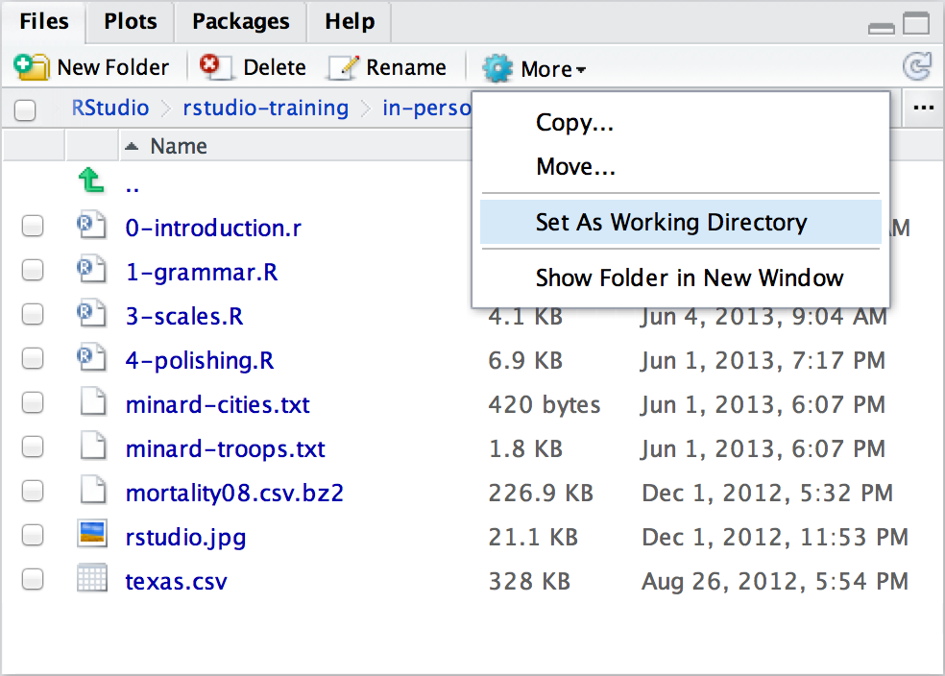
Changing the Working directory
Navigate in the files pane to a new directory. Click
More > Set As Working Directory
CC BY-SA RStudio

Slide 60
Saving plots
ggsave() saves the last plot.
Uses size on screen:
ggsave("my-plot.pdf")
ggsave("my-plot.png")
Specify size in inches
ggsave("my-plot.pdf", width = 6, height = 6)
CC BY-SA RStudio

Slide 61
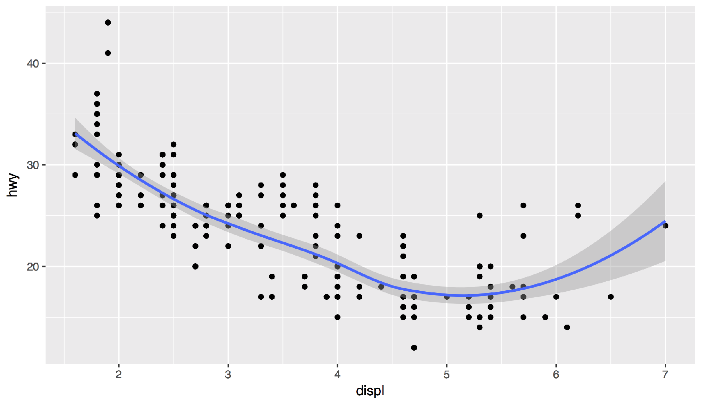
Your Turn 9
Save your last plot and then locate it in your files pane. (You may have to refresh the files list).

Slide 62
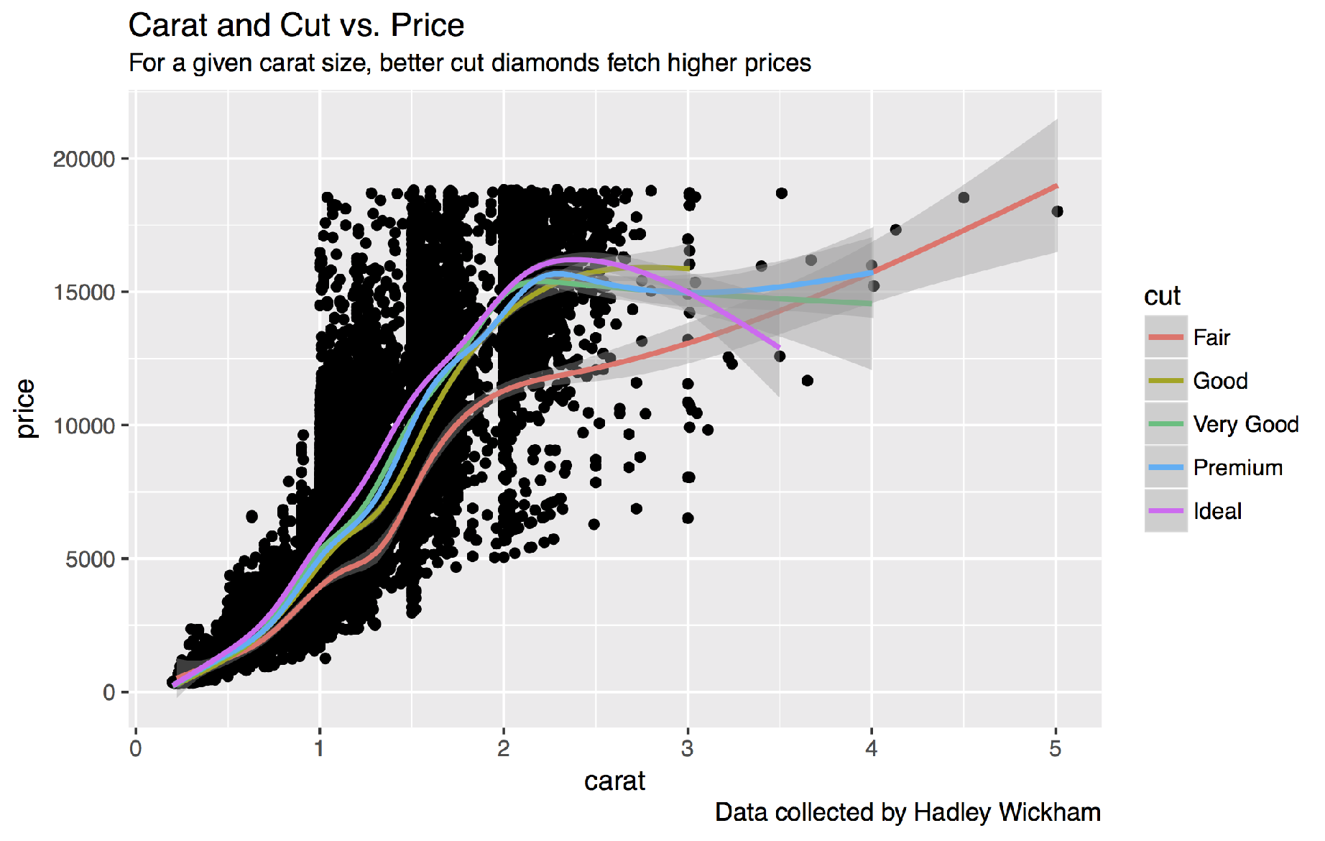
Your turn
Save your last plot and then locate it in your files pane.

Slide 63
Grammar
of Graphics

Slide 64
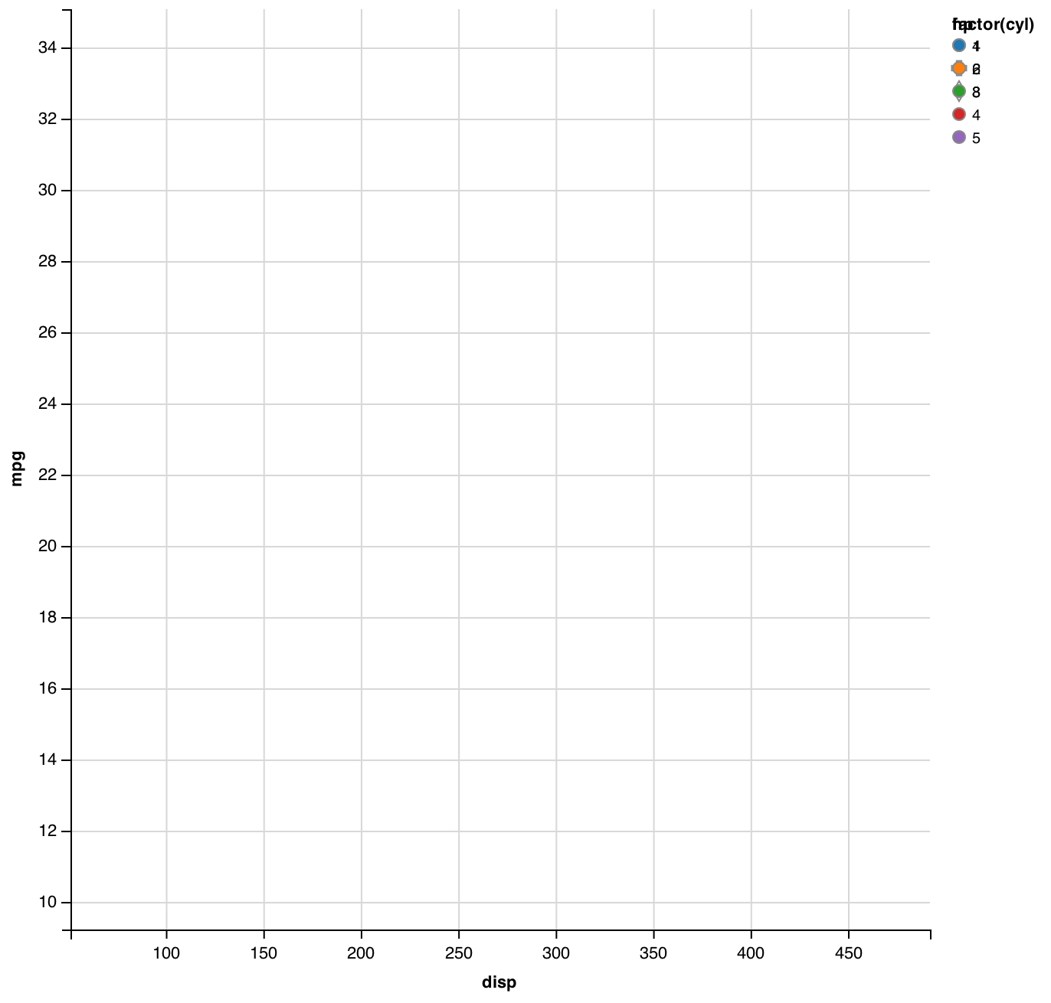
mpg | cyl | disp | hp
21.0 | 6 | 160.0 | 2
21.0 | 6 | 160.0 | 2
22.8 | 4 | 108.0 | 1
21.4 | 6 | 258.0 | 2
18.7 | 8 | 360.0 | 3
18.1 | 6 | 225.0 | 2
14.3 | 8 | 360.0 | 5
24.4 | 4 | 146.7 | 1
22.8 | 4 | 140.8 | 1
19.2 | 6 | 167.6 | 2
17.8 | 6 | 167.6 | 2
16.4 | 8 | 275.8 | 3
17.3 | 8 | 275.8 | 3
15.2 | 8 | 275.8 | 3
10.4 | 8 | 472.0 | 4
10.4 | 8 | 460.0 | 4
14.7 | 8 | 440.0 | 4
32.4 | 4 | 78.7 | 1
30.4 | 4 | 75.7 | 1
33.9 | 4 | 71.1 | 1
data
geom
CC BY-SA RStudio

Slide 65
mappings
fill
mpg | cyl | disp | hp
21.0 | 6 | 160.0 | 2
21.0 | 6 | 160.0 | 2
22.8 | 4 | 108.0 | 1
21.4 | 6 | 258.0 | 2
18.7 | 8 | 360.0 | 3
18.1 | 6 | 225.0 | 2
14.3 | 8 | 360.0 | 5
24.4 | 4 | 146.7 | 1
22.8 | 4 | 140.8 | 1
19.2 | 6 | 167.6 | 2
17.8 | 6 | 167.6 | 2
16.4 | 8 | 275.8 | 3
17.3 | 8 | 275.8 | 3
15.2 | 8 | 275.8 | 3
10.4 | 8 | 472.0 | 4
10.4 | 8 | 460.0 | 4
14.7 | 8 | 440.0 | 4
32.4 | 4 | 78.7 | 1
30.4 | 4 | 75.7 | 1
33.9 | 4 | 71.1 | 1
data
geom
CC BY-SA RStudio

Slide 66
mappings
shape
fill
mpg | cyl | disp | hp
21.0 | 6 | 160.0 | 2
21.0 | 6 | 160.0 | 2
22.8 | 4 | 108.0 | 1
21.4 | 6 | 258.0 | 2
18.7 | 8 | 360.0 | 3
18.1 | 6 | 225.0 | 2
14.3 | 8 | 360.0 | 5
24.4 | 4 | 146.7 | 1
22.8 | 4 | 140.8 | 1
19.2 | 6 | 167.6 | 2
17.8 | 6 | 167.6 | 2
16.4 | 8 | 275.8 | 3
17.3 | 8 | 275.8 | 3
15.2 | 8 | 275.8 | 3
10.4 | 8 | 472.0 | 4
10.4 | 8 | 460.0 | 4
14.7 | 8 | 440.0 | 4
32.4 | 4 | 78.7 | 1
30.4 | 4 | 75.7 | 1
33.9 | 4 | 71.1 | 1
data
geom
CC BY-SA RStudio

Slide 67
mappings
shape
x
fill
mpg | cyl | disp | hp
21.0 | 6 | 160.0 | 2
21.0 | 6 | 160.0 | 2
22.8 | 4 | 108.0 | 1
21.4 | 6 | 258.0 | 2
18.7 | 8 | 360.0 | 3
18.1 | 6 | 225.0 | 2
14.3 | 8 | 360.0 | 5
24.4 | 4 | 146.7 | 1
22.8 | 4 | 140.8 | 1
19.2 | 6 | 167.6 | 2
17.8 | 6 | 167.6 | 2
16.4 | 8 | 275.8 | 3
17.3 | 8 | 275.8 | 3
15.2 | 8 | 275.8 | 3
10.4 | 8 | 472.0 | 4
10.4 | 8 | 460.0 | 4
14.7 | 8 | 440.0 | 4
32.4 | 4 | 78.7 | 1
30.4 | 4 | 75.7 | 1
33.9 | 4 | 71.1 | 1
data
geom
CC BY-SA RStudio

Slide 68
mappings
y
shape
x
fill
mpg | cyl | disp | hp
21.0 | 6 | 160.0 | 2
21.0 | 6 | 160.0 | 2
22.8 | 4 | 108.0 | 1
21.4 | 6 | 258.0 | 2
18.7 | 8 | 360.0 | 3
18.1 | 6 | 225.0 | 2
14.3 | 8 | 360.0 | 5
24.4 | 4 | 146.7 | 1
22.8 | 4 | 140.8 | 1
19.2 | 6 | 167.6 | 2
17.8 | 6 | 167.6 | 2
16.4 | 8 | 275.8 | 3
17.3 | 8 | 275.8 | 3
15.2 | 8 | 275.8 | 3
10.4 | 8 | 472.0 | 4
10.4 | 8 | 460.0 | 4
14.7 | 8 | 440.0 | 4
32.4 | 4 | 78.7 | 1
30.4 | 4 | 75.7 | 1
33.9 | 4 | 71.1 | 1
data
geom
CC BY-SA RStudio

Slide 69
mappings
y
shape
x
fill
mpg | cyl | disp | hp
21.0 | 6 | 160.0 | 2
21.0 | 6 | 160.0 | 2
22.8 | 4 | 108.0 | 1
21.4 | 6 | 258.0 | 2
18.7 | 8 | 360.0 | 3
18.1 | 6 | 225.0 | 2
14.3 | 8 | 360.0 | 5
24.4 | 4 | 146.7 | 1
22.8 | 4 | 140.8 | 1
19.2 | 6 | 167.6 | 2
17.8 | 6 | 167.6 | 2
16.4 | 8 | 275.8 | 3
17.3 | 8 | 275.8 | 3
15.2 | 8 | 275.8 | 3
10.4 | 8 | 472.0 | 4
10.4 | 8 | 460.0 | 4
14.7 | 8 | 440.0 | 4
32.4 | 4 | 78.7 | 1
30.4 | 4 | 75.7 | 1
33.9 | 4 | 71.1 | 1
data
geom
points
CC BY-SA RStudio
lines

Slide 70
mappings
y
x
mpg | cyl | disp | hp
21.0 | 6 | 160.0 | 2
21.0 | 6 | 160.0 | 2
22.8 | 4 | 108.0 | 1
21.4 | 6 | 258.0 | 2
18.7 | 8 | 360.0 | 3
18.1 | 6 | 225.0 | 2
14.3 | 8 | 360.0 | 5
24.4 | 4 | 146.7 | 1
22.8 | 4 | 140.8 | 1
19.2 | 6 | 167.6 | 2
17.8 | 6 | 167.6 | 2
16.4 | 8 | 275.8 | 3
17.3 | 8 | 275.8 | 3
15.2 | 8 | 275.8 | 3
10.4 | 8 | 472.0 | 4
10.4 | 8 | 460.0 | 4
14.7 | 8 | 440.0 | 4
32.4 | 4 | 78.7 | 1
30.4 | 4 | 75.7 | 1
33.9 | 4 | 71.1 | 1
data
geom
points
CC BY-SA RStudio
lines
bars

Slide 71
mappings
y
x
fill
mpg | cyl | disp | hp
21.0 | 6 | 160.0 | 2
21.0 | 6 | 160.0 | 2
22.8 | 4 | 108.0 | 1
21.4 | 6 | 258.0 | 2
18.7 | 8 | 360.0 | 3
18.1 | 6 | 225.0 | 2
14.3 | 8 | 360.0 | 5
24.4 | 4 | 146.7 | 1
22.8 | 4 | 140.8 | 1
19.2 | 6 | 167.6 | 2
17.8 | 6 | 167.6 | 2
16.4 | 8 | 275.8 | 3
17.3 | 8 | 275.8 | 3
15.2 | 8 | 275.8 | 3
10.4 | 8 | 472.0 | 4
10.4 | 8 | 460.0 | 4
14.7 | 8 | 440.0 | 4
32.4 | 4 | 78.7 | 1
30.4 | 4 | 75.7 | 1
33.9 | 4 | 71.1 | 1
data
geom
points
CC BY-SA RStudio
lines
bars

Slide 72
To make a graph
[template]
ggplot(data = <DATA>) +
<GEOM_FUNCTION>(mapping = aes(<MAPPINGS>))
CC BY-SA RStudio

Slide 73
To make a graph
mpg | cyl | disp | hp
21.0 | 6 | 160.0 | 2
21.0 | 6 | 160.0 | 2
22.8 | 4 | 108.0 | 1
21.4 | 6 | 258.0 | 2
18.7 | 8 | 360.0 | 3
18.1 | 6 | 225.0 | 2
14.3 | 8 | 360.0 | 5
24.4 | 4 | 146.7 | 1
22.8 | 4 | 140.8 | 1
19.2 | 6 | 167.6 | 2
17.8 | 6 | 167.6 | 2
16.4 | 8 | 275.8 | 3
17.3 | 8 | 275.8 | 3
15.2 | 8 | 275.8 | 3
10.4 | 8 | 472.0 | 4
10.4 | 8 | 460.0 | 4
14.7 | 8 | 440.0 | 4
32.4 | 4 | 78.7 | 1
30.4 | 4 | 75.7 | 1
33.9 | 4 | 71.1 | 1
Pick a data set
ggplot(data = <DATA>) +
<GEOM_FUNCTION>(mapping = aes(<MAPPINGS>))
data
CC BY-SA RStudio

Slide 74
To make a graph
mpg | cyl | disp | hp
21.0 | 6 | 160.0 | 2
21.0 | 6 | 160.0 | 2
22.8 | 4 | 108.0 | 1
21.4 | 6 | 258.0 | 2
18.7 | 8 | 360.0 | 3
18.1 | 6 | 225.0 | 2
14.3 | 8 | 360.0 | 5
24.4 | 4 | 146.7 | 1
22.8 | 4 | 140.8 | 1
19.2 | 6 | 167.6 | 2
17.8 | 6 | 167.6 | 2
16.4 | 8 | 275.8 | 3
17.3 | 8 | 275.8 | 3
15.2 | 8 | 275.8 | 3
10.4 | 8 | 472.0 | 4
10.4 | 8 | 460.0 | 4
14.7 | 8 | 440.0 | 4
32.4 | 4 | 78.7 | 1
30.4 | 4 | 75.7 | 1
33.9 | 4 | 71.1 | 1
Pick a data set
ggplot(data = <DATA>) +
<GEOM_FUNCTION>(mapping = aes(<MAPPINGS>))
Choose a geom to display cases
data
geom
CC BY-SA RStudio

Slide 75
To make a graph
mappings
fill
mpg | cyl | disp | hp
21.0 | 6 | 160.0 | 2
21.0 | 6 | 160.0 | 2
22.8 | 4 | 108.0 | 1
21.4 | 6 | 258.0 | 2
18.7 | 8 | 360.0 | 3
18.1 | 6 | 225.0 | 2
14.3 | 8 | 360.0 | 5
24.4 | 4 | 146.7 | 1
22.8 | 4 | 140.8 | 1
19.2 | 6 | 167.6 | 2
17.8 | 6 | 167.6 | 2
16.4 | 8 | 275.8 | 3
17.3 | 8 | 275.8 | 3
15.2 | 8 | 275.8 | 3
10.4 | 8 | 472.0 | 4
10.4 | 8 | 460.0 | 4
14.7 | 8 | 440.0 | 4
32.4 | 4 | 78.7 | 1
30.4 | 4 | 75.7 | 1
33.9 | 4 | 71.1 | 1
Pick a data set
ggplot(data = <DATA>) +
<GEOM_FUNCTION>(mapping = aes(<MAPPINGS>))
Map aesthetic properties to variables
Choose a geom to display cases
data
geom
CC BY-SA RStudio

Slide 76
What else?

Slide 77
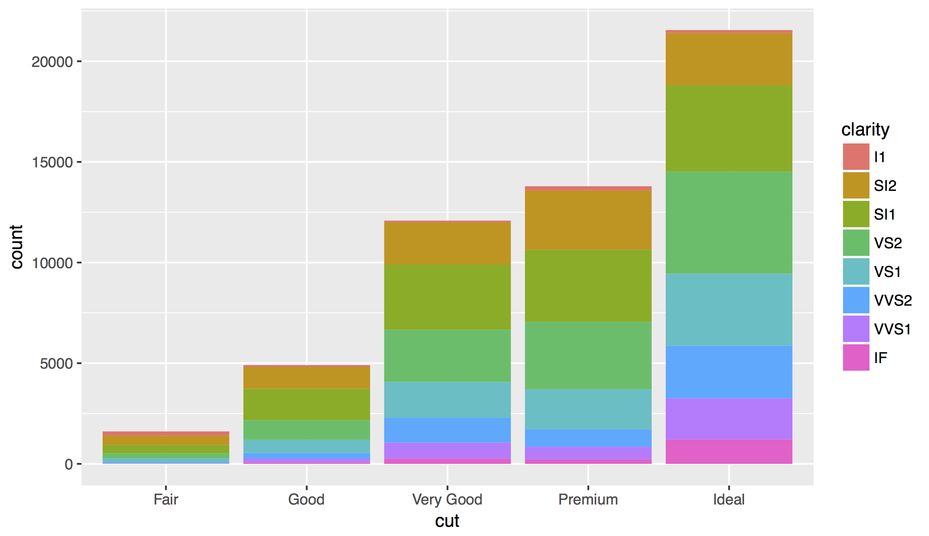
CC BY-SA RStudio

Slide 78
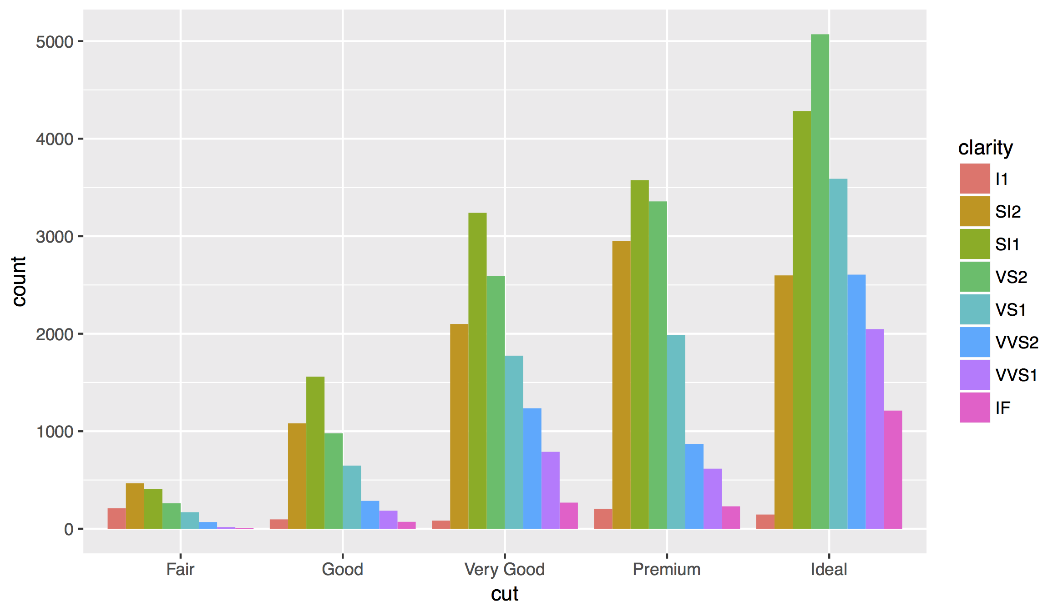
Position Adjustments
How overlapping objects are arranged
CC BY-SA RStudio

Slide 79
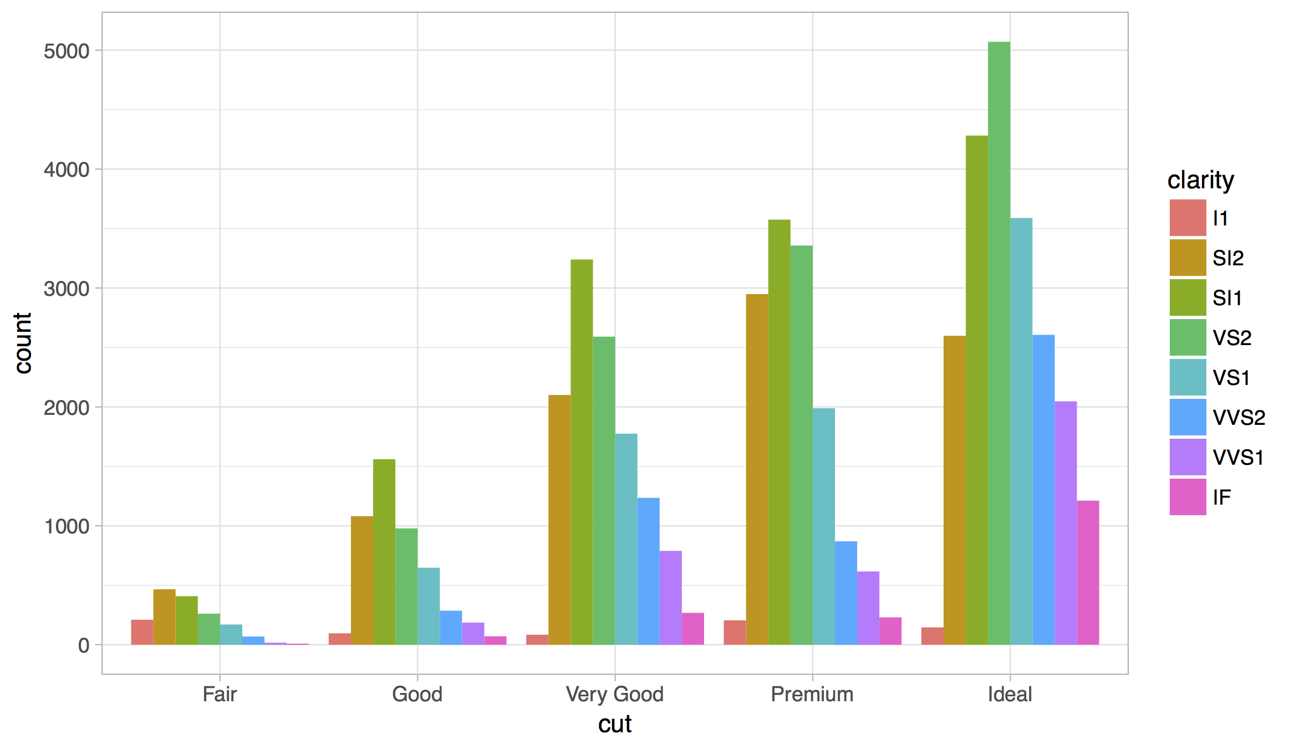
Themes
Visual appearance of non-data elements
CC BY-SA RStudio

Slide 80
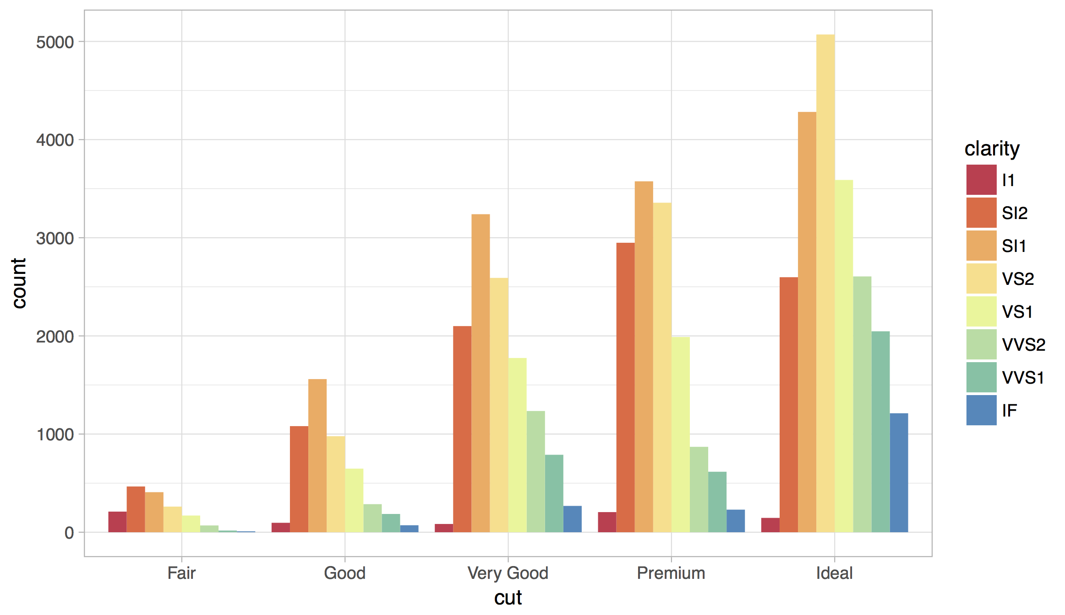
Scales
Customize color scales, other mappings
CC BY-SA RStudio

Slide 81

Facets
Subplots that display subsets of the data.
CC BY-SA RStudio

Slide 82

Coordinate systems
CC BY-SA RStudio

Slide 83

Titles and captions
CC BY-SA RStudio

Slide 84


A ggplot2 template
Make any plot by filling in the parameters of this template
CC BY-SA RStudio

Slide 85

ggplot2.tidyverse.org
CC BY-SA RStudio

Slide 86
Your Turn
Open 02-Transform-Data.Rmd.

